Slide 1
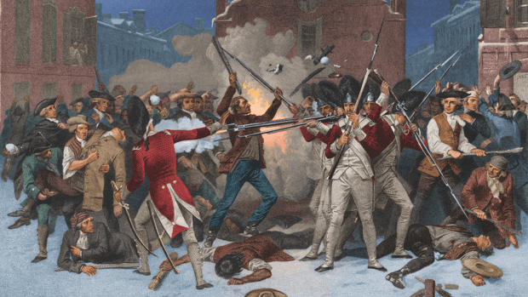
American Revolution 5
Charlie Li

Slide 2
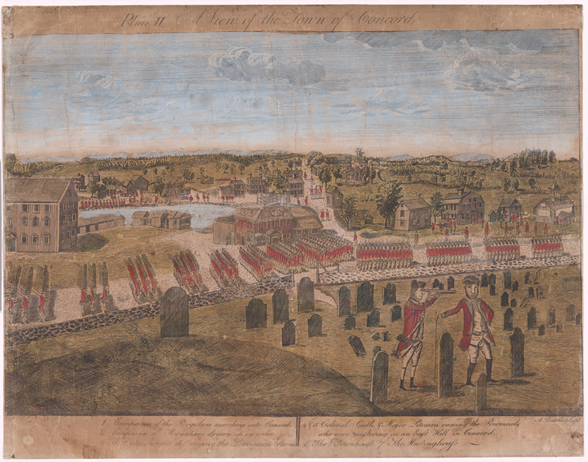
Battle of Lexington and Concord
1775, British attack Lexington and Concord
British soldiers vs minutemen
300 British causalities
significance

Slide 3
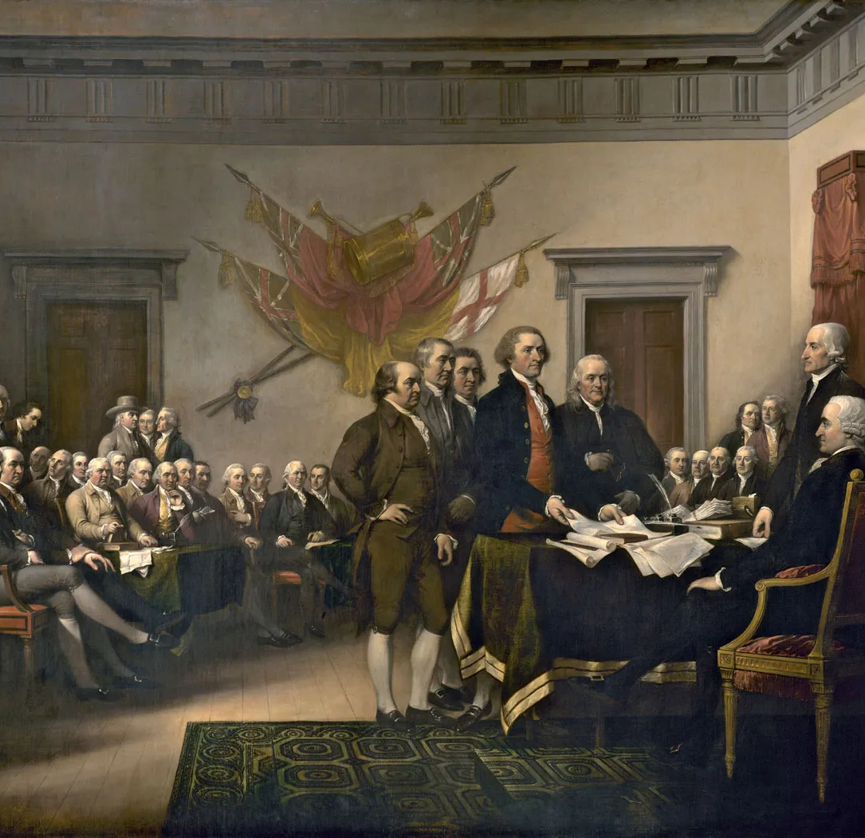
Second Continental Congress 1775
Conservatives: John Jay and John Dickinson
Radicals: John Adams and Thomas Jefferson
Olive Branch Petition, July 5
Declaration of the Causes and Necessity of Taking Up Arms
George Washintgon

Slide 4
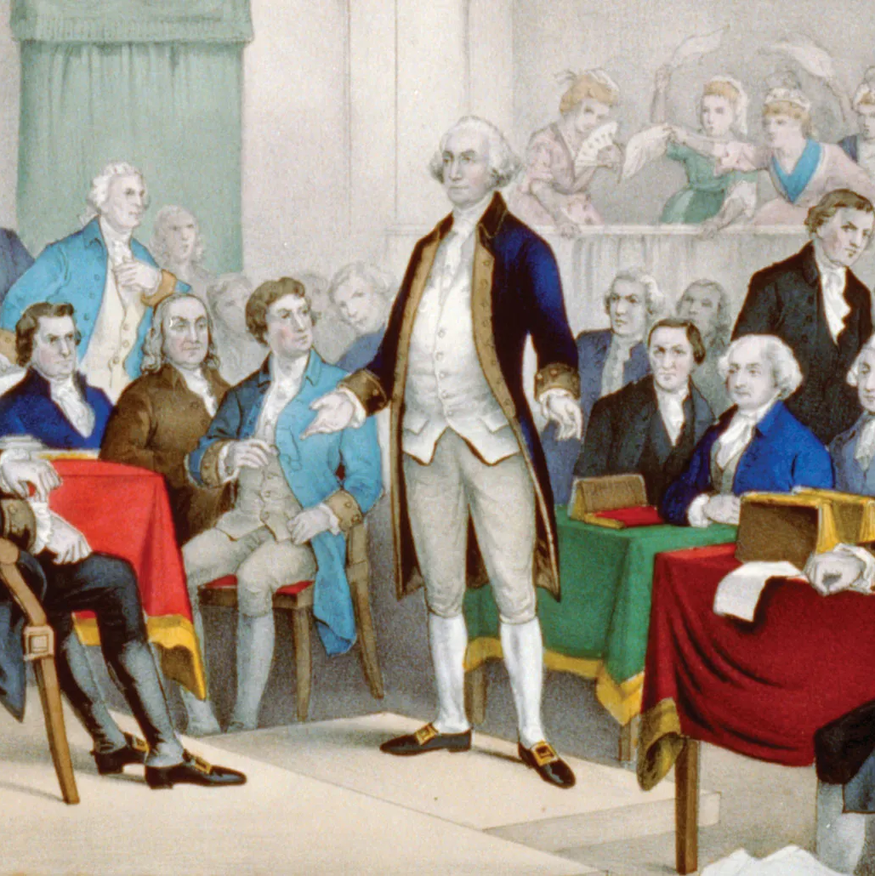
Continued 1776
Appointing ambassadors, issuing paper currency, Continental army
X raise taxes, regulate commerce
Declaration of Independence

Slide 5
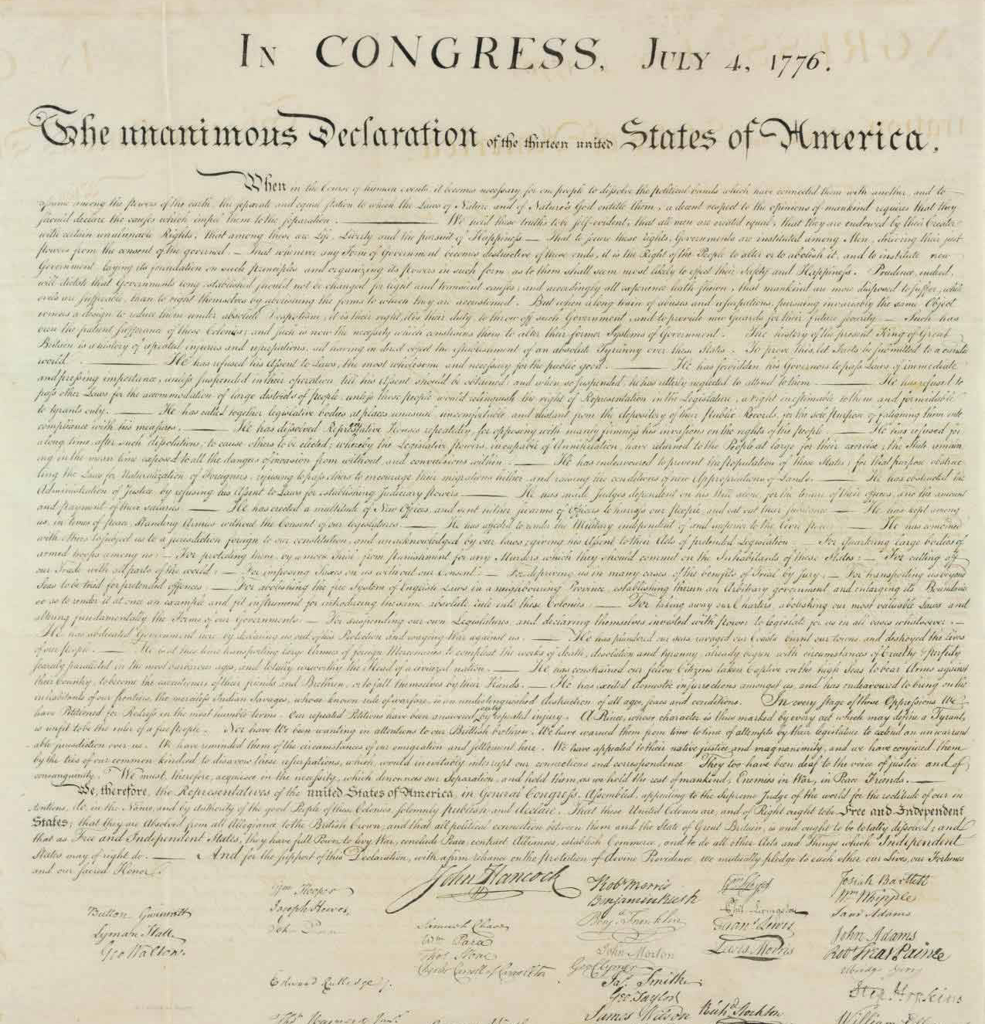
Declaration of Independence
The unanimous Declaration of the thirteen united States of America: When in the Course of human events, it becomes necessary for one people to dissolve the political bands which have connected them with another, and to assume among the powers of the earth, the separate and equal station to which the Laws of Nature and of Nature's God entitle them, a decent respect to the opinions of mankind requires that they should declare the causes which impel them to the separation.
We hold these truths to be self-evident, that all men are created equal, that they are endowed by their Creator with certain unalienable Rights, that among these are Life, Liberty and the pursuit of Happiness.--That to secure these rights, Governments are instituted among Men, deriving their just powers from the consent of the governed, --That whenever any Form of Government becomes destructive of these ends, it is the Right of the People to alter or to abolish it, and to institute new Government, laying its foundation on such principles and organizing its powers in such form, as to them shall seem most likely to effect their Safety and Happiness.

Slide 6
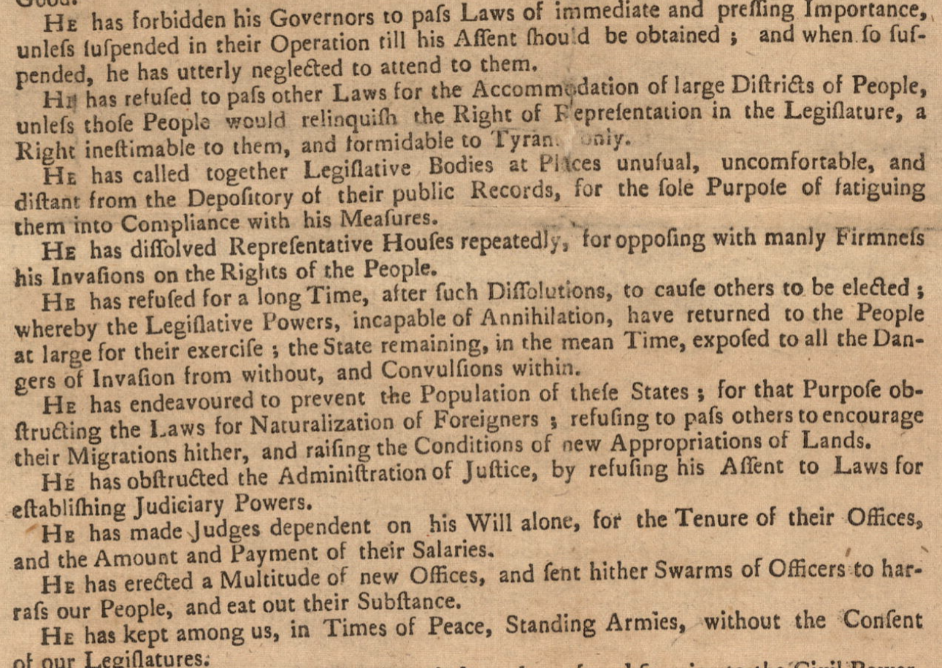
Continued
He has kept among us, in times of peace, Standing Armies without the Consent of our legislatures.
For cutting off our Trade with all parts of the world:
For imposing Taxes on us without our Consent:
For depriving us in many cases, of the benefits of Trial by Jury:
For transporting us beyond Seas to be tried for pretended offences

Slide 7
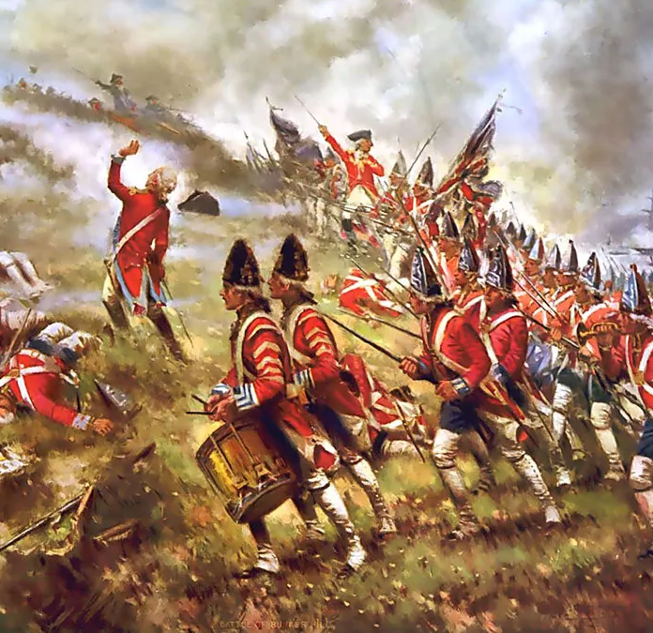
The Battle of Long Island
Hessians: mercenaries
35,000 troops to NYC in July
Washington lost, retreated to Jersey

