Slide 1
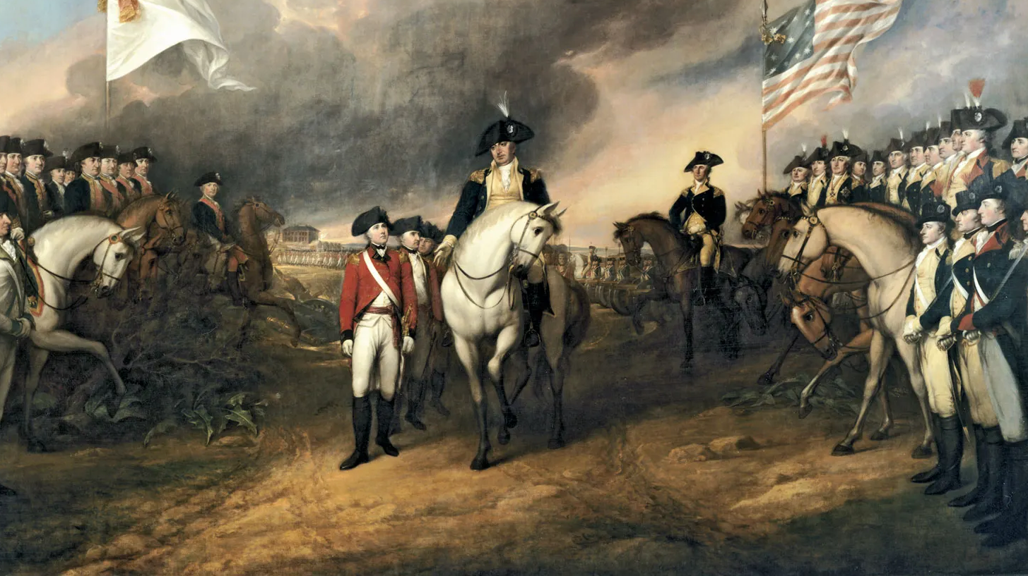
American Revolution 4
Charlie Li

Slide 2
Questions to think about
Was Britain’s divide-and-conquer strategy effective? Why was Boston singled out for punishment?
What do you think was most significant about the First Continental Congress?

Slide 3
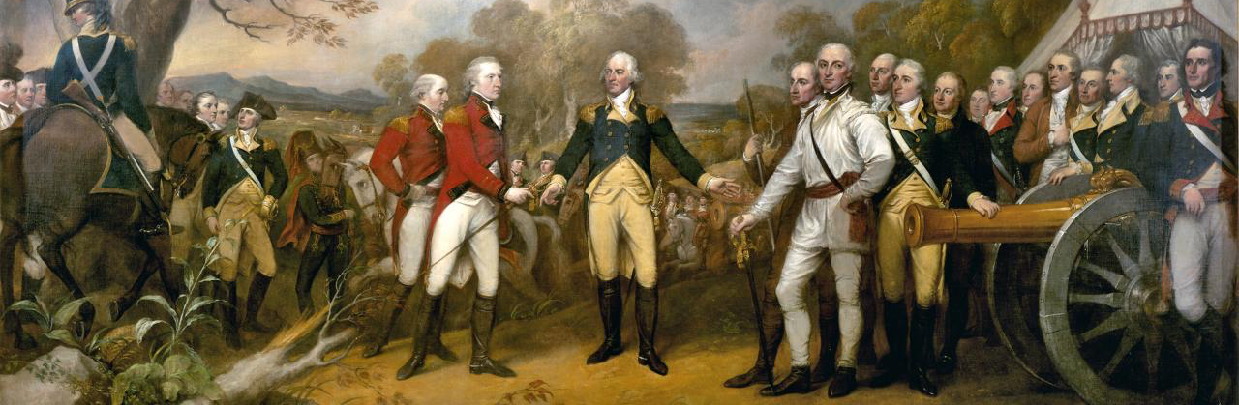
Causes of The American Revolution
Unfairly taxed, no representation
Resentful of British troops
Further resentment from Quartering and Intolerable Acts
Enlightenment
Patriotism

Slide 4
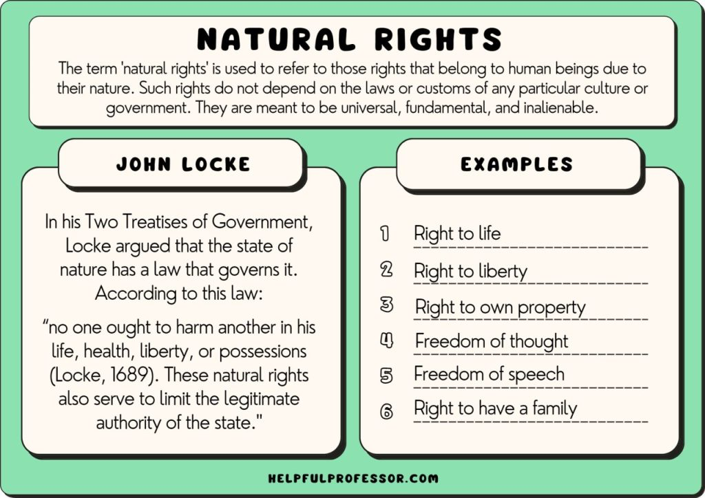
Enlightenment
Philosophical movement that emerged in 18th-century Europe and emphasized reason, individualism, and skepticism
John Locke: natural rights
Thomas Hobbes & Jean-Jacques Rousseau: social contract
Baron de Montesquieu: separation of powers

Slide 5
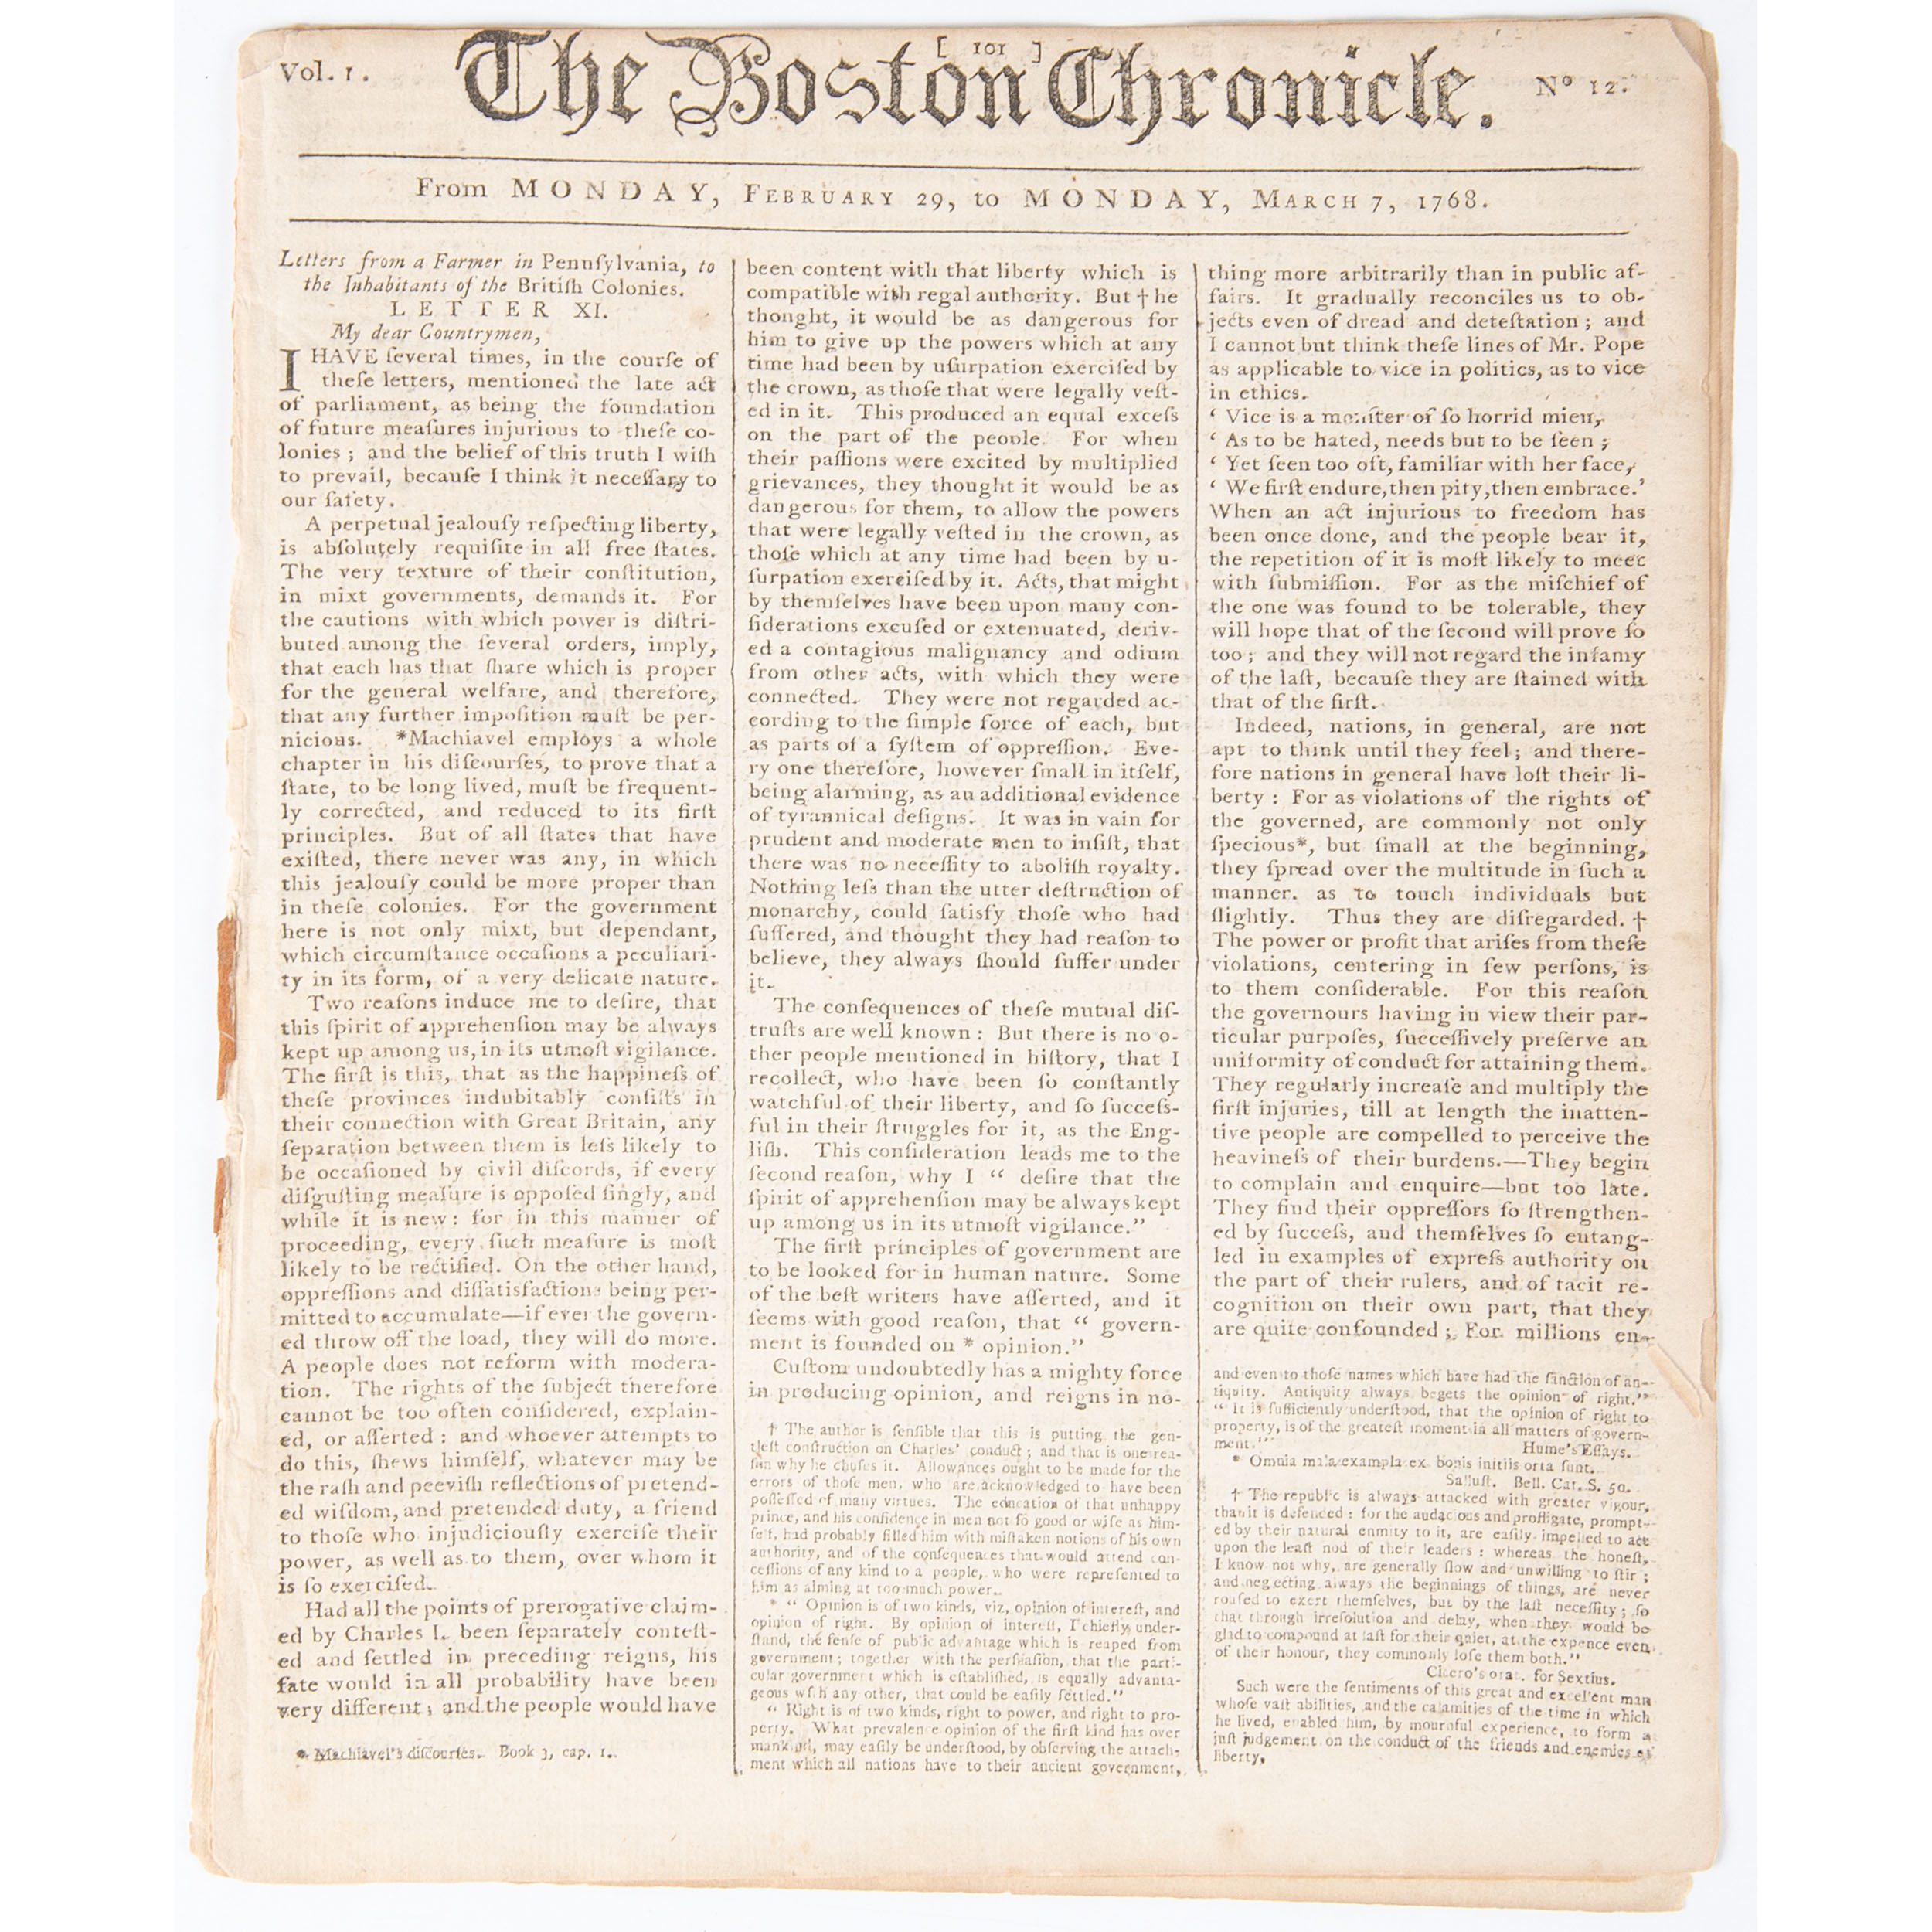
Letters from a Farmer in Pennsylvania

Slide 6
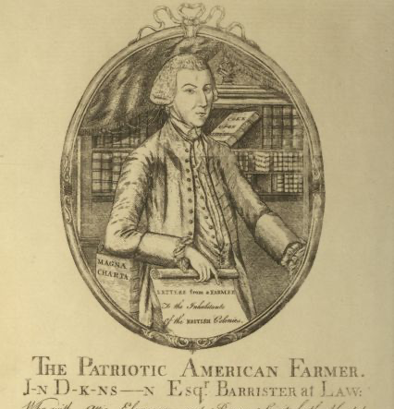
Letters from a Farmer in Pennsylvania
Great Britain has prohibited the manufacturing iron and steel in these colonies, without any objection being made to her right of doing it. The like right she must have to prohibit any other manufacture among us. Thus she is possessed of an undisputed precedent on that point. This authority, she will say, is founded on the original intention of settling these colonies; that is, that we should manufacture for them, and that they should supply her with materials. The equity of this policy, she will also say, has been universally acknowledged by the colonies, who never have made the least objection to statutes for that purpose; and will further appear by the mutual benefits flowing from this usage ever since the settlement of these colonies….
Here then, my dear countrymen, ROUSE yourselves, and behold the ruin hanging over your heads….
Upon the whole, the single question is, whether the Parliament can legally impose duties to be paid by the people of these colonies only, FOR THE SOLE PURPOSE OF RAISING A REVENUE, on commodities which she obliges us to take from her alone, or, in other words, whether the Parliament can legally take money out of our pockets, without our consent….

Slide 7
Hamilton
https://www.youtube.com/watch?v=r1izVfVpBwE
https://www.youtube.com/watch?v=d6ViwFa9Paw

Slide 8
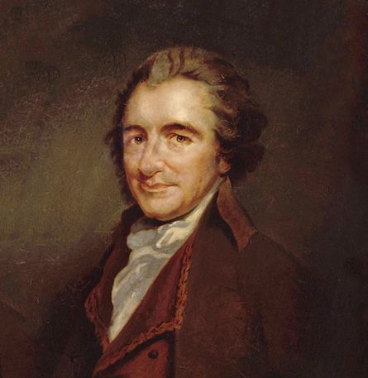
Common Sense
‘In short, monarchy and succession have laid (not this or that kingdom only) but the world in blood and ashes.’
‘Of more worth is one honest man to society and in the sight of God, than all the crowned ruffians that ever lived.’
‘I offer nothing more than simple facts, plain arguments, and common sense.’

