Slide 1
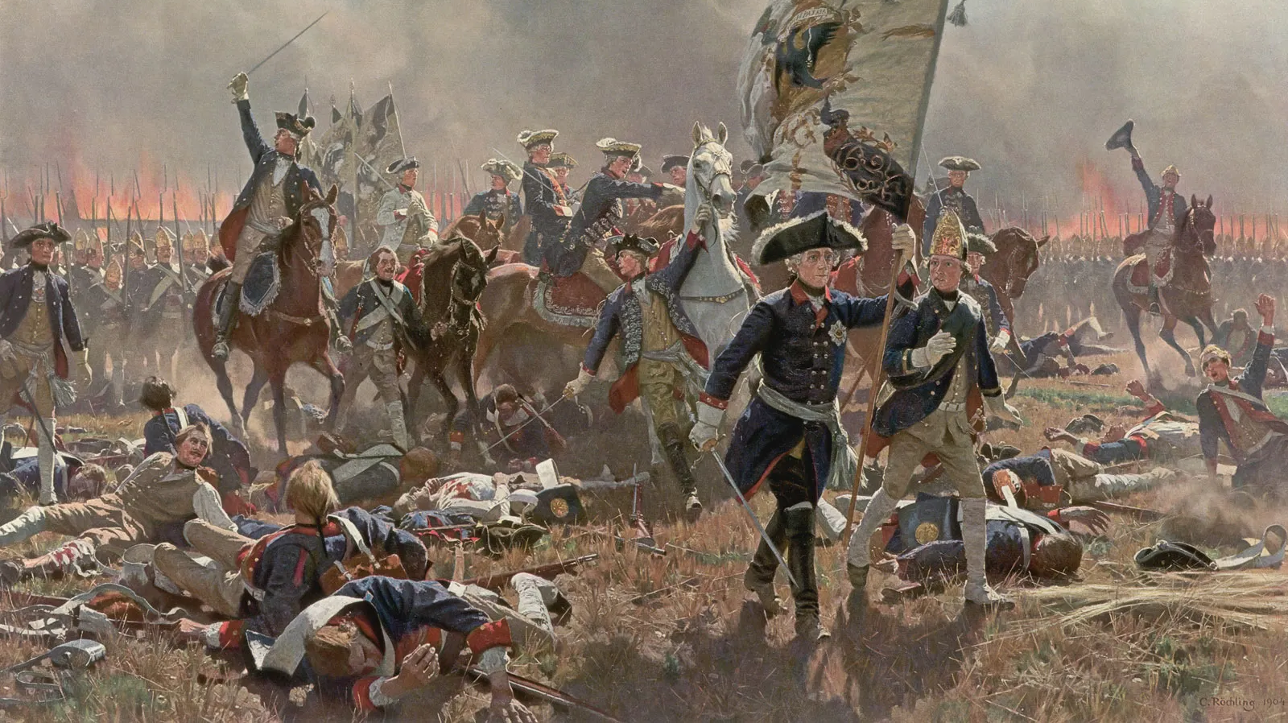
American Revolution Class #2
Charlie Li

Slide 2
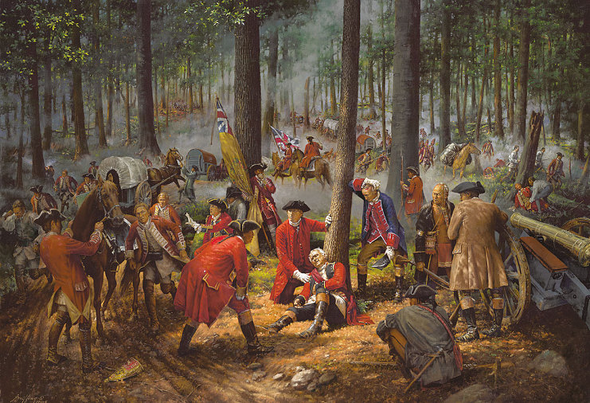
End of War
Battle of Quebec
French was defeated

Slide 3
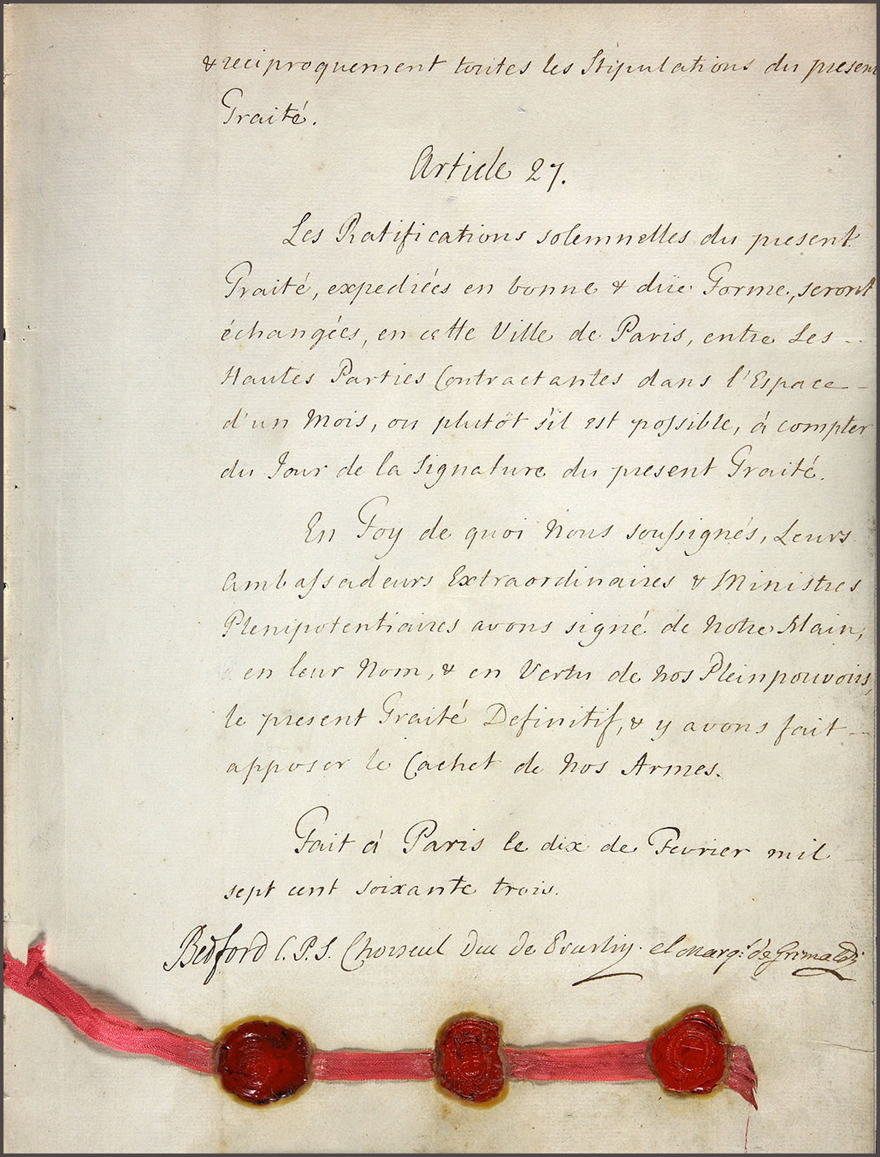
Treaty of Paris 1763
Ceded land west of Mississippi
Sugar Island in Caribbean
Fort Niagara and Fort Detroi
Florida -> Havana

Slide 4
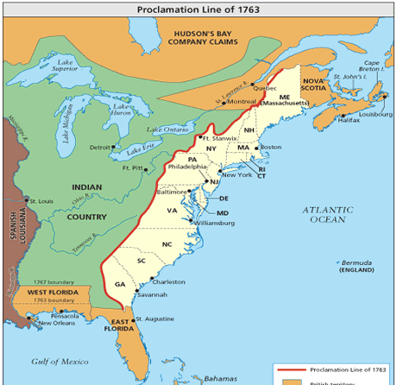
Consequences and Effects
Colonists travelled west
Proclamation of 1763
Cause British in debt
X Salutary Negelct

Slide 5
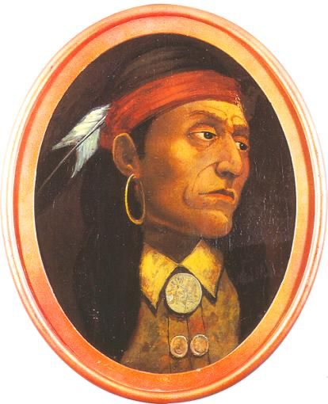
Pontiac’s Rebellion
Pontiac was a leader of the Odawa tribe located in the area of modern-day Ontario, Canada, and the Great Lakes region.
He led a rebellion against the British colonists after they expanded their military presence in the Great Lakes area during and after the French and Indian War.
Pontiac’s uprising demonstrated the viability of pantribal cooperation in the struggle against European-American territorial expansionism and contributed to the deterioration of relations between Great Britain and its North American colonies.

Slide 6
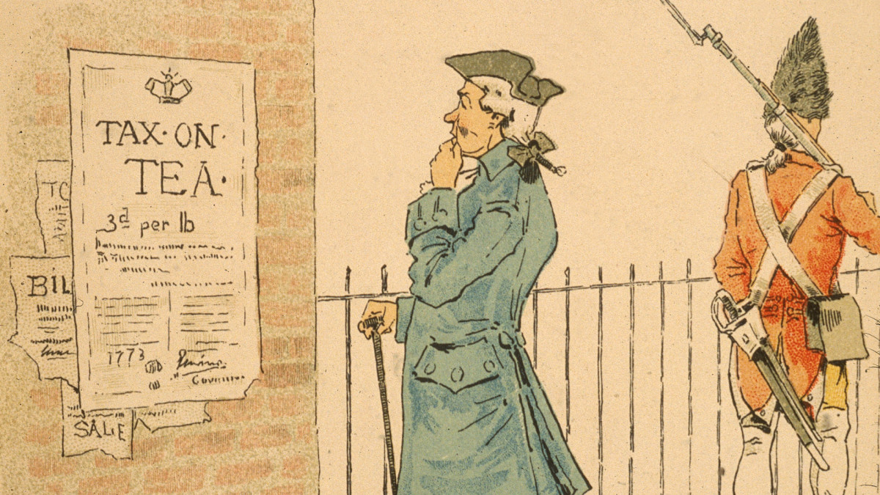
New laws and policies
The Sugar Act of 1764
The Quartering Act of 1765
The Stamp Act of 1765
The Townshend Acts of 1767
The Tea Act of 1773
The Navigation Acts

Slide 7
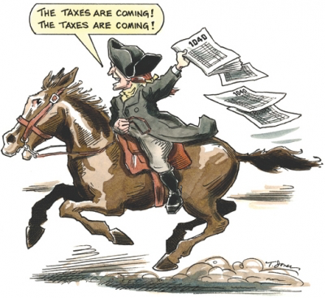
No Taxation Without Representation
Protest slogan
Stamp Act Congress 1765

