Slide 1
Psychology and life
Session 4: Intro to Psychology
Lillian Liao Culver Academies

Slide 2
Perspectives
Structuralism
Functionalism
Gestalt Psychology Psychoanalysis
Behaviorism
Humanistic
Cognitivism

Slide 3
Gestalt Psychology
Looks at the human mind and behavior as a whole
Suggests that we do not simply focus on every small component
A core belief: ________(the whole is greater than the sum of its parts)

Slide 4
Psychoanalysis
Method of treating mental disorders
Emphasize how ________ influence influence behavior and personality

Slide 5
Psychoanalysis
Freud’s structure of personality: the _____, ______, and ________
The _____
- the unconscious,
- holds primitive desires and urges.
- isn’t rational or accessible, it is instinctual
The ______
- embodies a person’s higher moral code
- responsible for self-control, decision-making, and sacrifice
(abilities that allow an individual to live well with others in society)
- conflicts with the impulsive id
The ______
- represents the self
- balances and resolves conflicts between two competing forces
- tasks of reality: perception, cognition, and executive actions

Slide 6
Behaviorism
Seek to explain human behavior
Believes that human behavior is shaped by the ________
Doesn’t focus on internal thoughts, instead focuses on behavioral outputs
Emphasizes ________ and response
behavioral therapy techniques are used to help with developing new skills, connecting the steps required to complete a task, and rewarding desired behavior,
Laid the groundwork for understanding how we learn

Slide 7
Classical Conditioning
_________: A stimulus that does not initially elicit a response
____________-: A stimulus that causes a reflexive response
__________: A natural reaction to a given stimulus
____________: A stimulus that causes a response after repeatedly being paired with an unconditioned stimulus
______________: The response caused by the conditioned stimulus

Slide 8
Humanistic Psychology
Criticism of Freudian psychology and Behaviorism
- believes that it has a dark, pessimistic view on human nature
Founded by Abraham Maslow and Carl Rogers.
believes that humans have great potential of_________
Believes that people are innately ______ and that mental and social problems result from deviations from this natural tendency
stresses the importance of self-________
Therapists should encourage this through nonjudgmental support

Slide 9
Positive Psychology
&
Transpersonal Psychology

Slide 10
Cognitive psychology
Focuses on mental processes
It emphasizes the role of cognition, or mental activities and processes, in understanding human behavior
Criticize Behaviorism as it focuses only on behavior and neglected to explain cognition
Studies internal mental processes:
perception
thinking
memory
attention
language
problem-solving
learning

Slide 11
Perception
includes the five senses: _____________________
We perceive our environment using each of these, often simultaneously (___________)
Different types of perception in psychology:
Person perception: _______________
Social perception: ________________
Selective perception: _________________

Slide 12
Thinking Processes
Perception
Thinking
Memory
Attention
Language
problem-solving
Learning

Slide 13
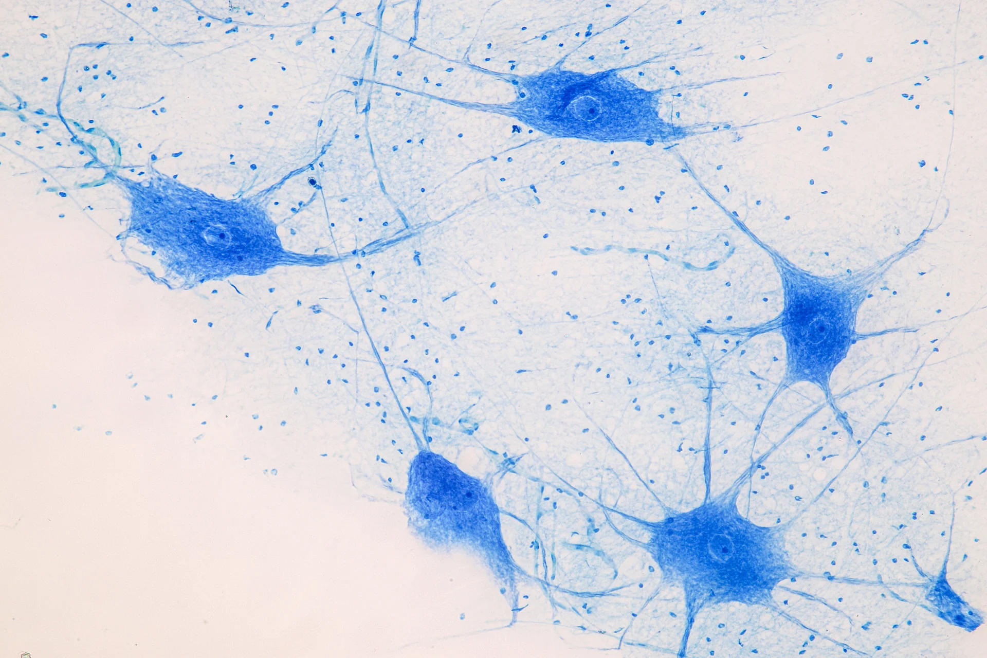

Slide 14
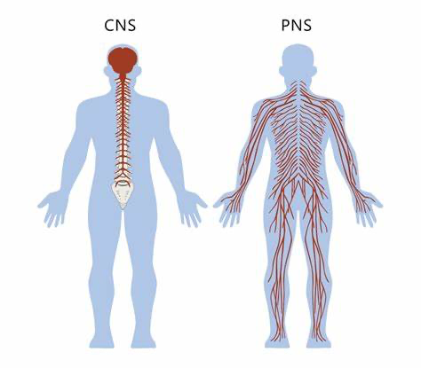
The 2 Nervous systems
The CNS (Central Nervous System): includes the brain and the spinal cord
The PNS (Peripheral Nervous System): includes all the nerves that branch out from the brain and the spinal cord and extend to parts of the body including muscles and organs

Slide 15
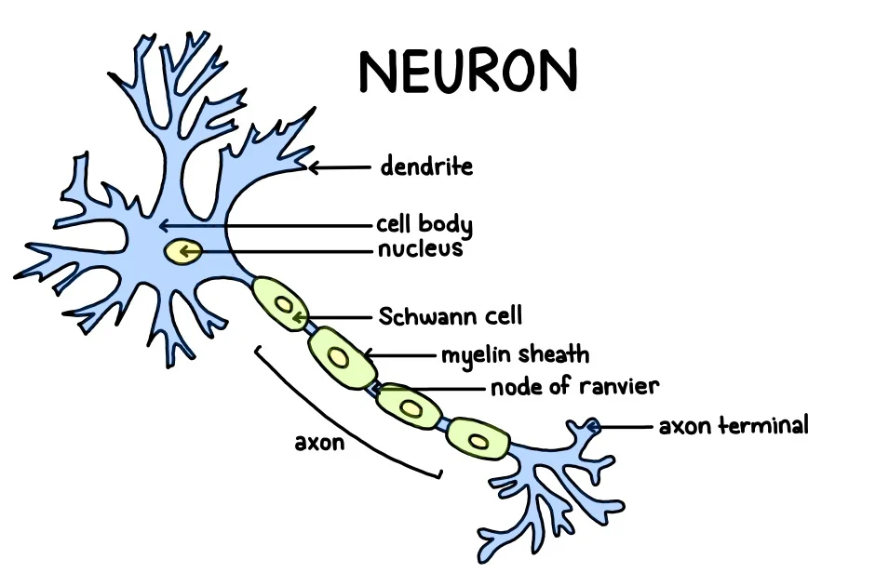
Neurons (Nerve Cells)

Slide 16
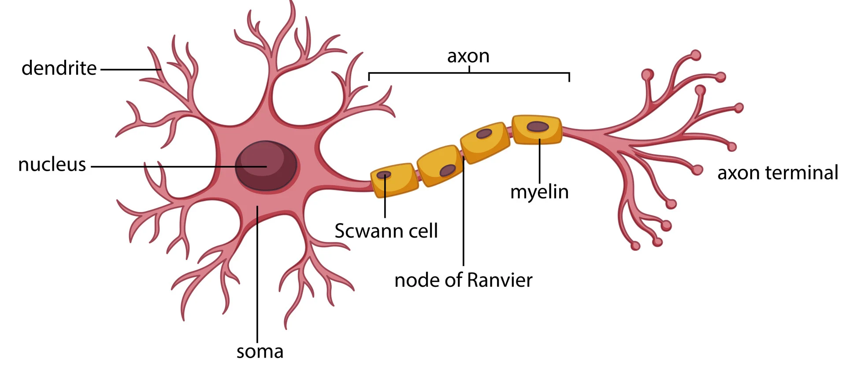
Neurons
Soma: cell body
Dendrite: tree-like structures that receive signals from other neurons
Axon: a nerve fiber conducting electrical impulses away from the soma
Myelin Sheath: a protective layer that forms around the axon

Slide 17
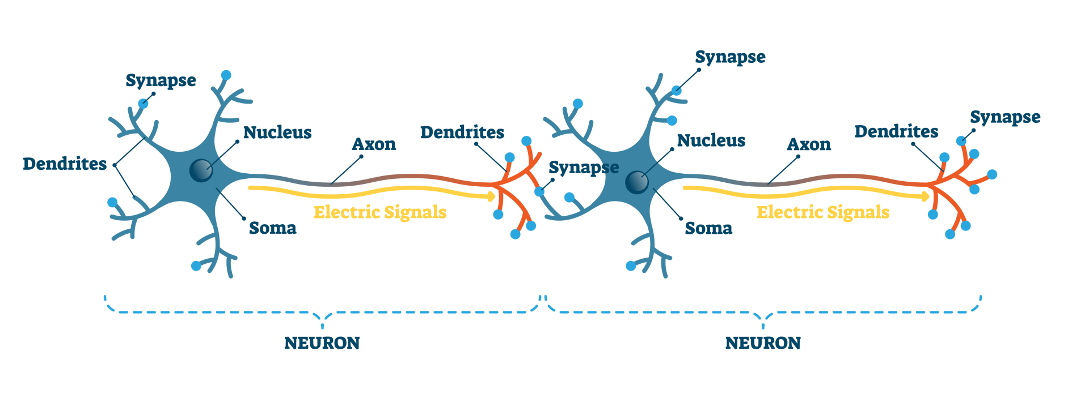
How signals are passed
The electrical signal needs to cross the synaptic gap. This is done using chemicals that diffuse across the gap between the two neurons. These chemicals are called neurotransmitters
These neurotransmitters diffuse across the synaptic gap and bind to receptor sites on the post-synaptic neuron. This will then trigger an electrical impulse in the adjacent cell

Slide 18
Neurotransmitters
Chemical messengers that carry signals between neurons and target cells throughout the body
Some common neurotransmitters in the brain and body include serotonin, dopamine, and endorphins

Slide 19
Dopamine:
known as the feel-good neurotransmitter, dopamine is involved in reward, motivation, and additions. This chemical messenger also plays an important role in the coordination of body movements.
Parkinson's disease is caused by the loss of dopamine-generating neurons
Endorphins:
These neurotransmitters inhibit the transmission of pain signals and promote feelings of euphoria
These chemical messengers are produced naturally by the body in response to pain
Serotonin:
serotonin plays an important role in regulating and modulating mood, sleep, anxiety, sexuality, and appetite
Selective serotonin reuptake inhibitors (SSRIs) are a type of antidepressant medication commonly prescribed to treat depression, anxiety, panic disorder, and panic attacks.

Slide 20
Memory
Refers to the psychological processes of acquiring, storing, retaining, and later retrieving information
Researchers believed that memories form due to changes in brain neurons
Memories are created through the connections that exist between these neurons, strengthening these connections helps commit information to memory
This is why reviewing and rehearsing information improves the ability to remember it. Practice strengthens the connections between the synapses that store that memory.

Slide 21
Types of memory
Sensory Memory：
the earliest stage of memory
During this stage, sensory information from the environment is stored for a very brief period
Generally, for no longer than 0.5 second for visual information and 3 or 4 seconds for auditory information.

Slide 22
Types of memory
Short-Term Memory
Also known as active memory. It is the information we are currently aware of or thinking about
In Freudian psychology, this memory would be referred to as the conscious mind
Most of the information stored in active memory will be kept for approximately 20 to 30 seconds (this capacity can be stretched through strategy and practice)
While short-term memory can be forgotten fast, it can be turned into long-term memory

Slide 23
Types of memory
Long-Term Memory
refers to the continuing storage of information
In Freudian psychology, this memory would be referred to as the unconscious
This information is largely outside of our awareness but can be called into working memory to be used when needed
Some memories are easy to recall, while others are much more difficult to access
Implicit memory & Explicit memory

Slide 24
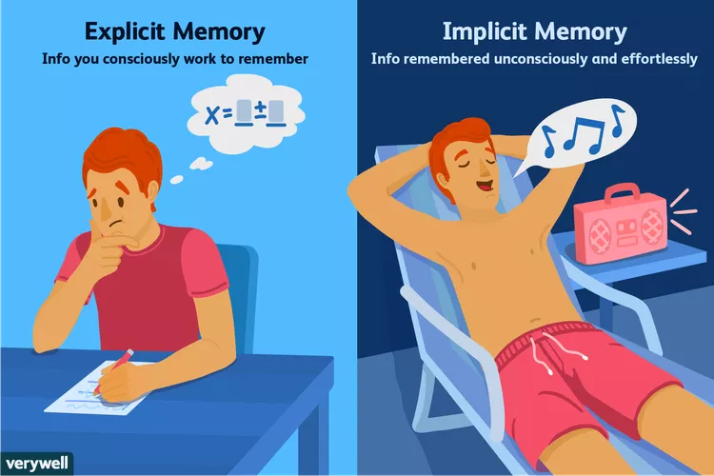
Implicit & Explicit memory
Types of long-term memory

Slide 25
Implicit memory
Information that people don't purposely try to remember, sometimes referred to as unconscious memory or automatic memory
This kind of memory is both unconscious and unintentional
Implicit memories are often procedural and focused on the step-by-step processes that must be performed, such as walking or running.
e.g., singing a familiar song, typing on your computer keyboard, and brushing your teeth. Riding a bike is another example. Even after going years without riding one, most people can hop on a bike and ride it effortlessly.
Classical Conditioning is also an example

Slide 26
Explicit memory
When you're trying to intentionally remember something
Also known as declarative memory since you can consciously recall and explain the information
e.g., like a formula for your math class or a friend’s phone number
Two types of Explicit Memory:
Episodic memory: These are your long-term memories of specific events, such as what you did yesterday or your high school graduation
Semantic memory: These are memories of facts, concepts, names, and other general knowledge

