Slide 1
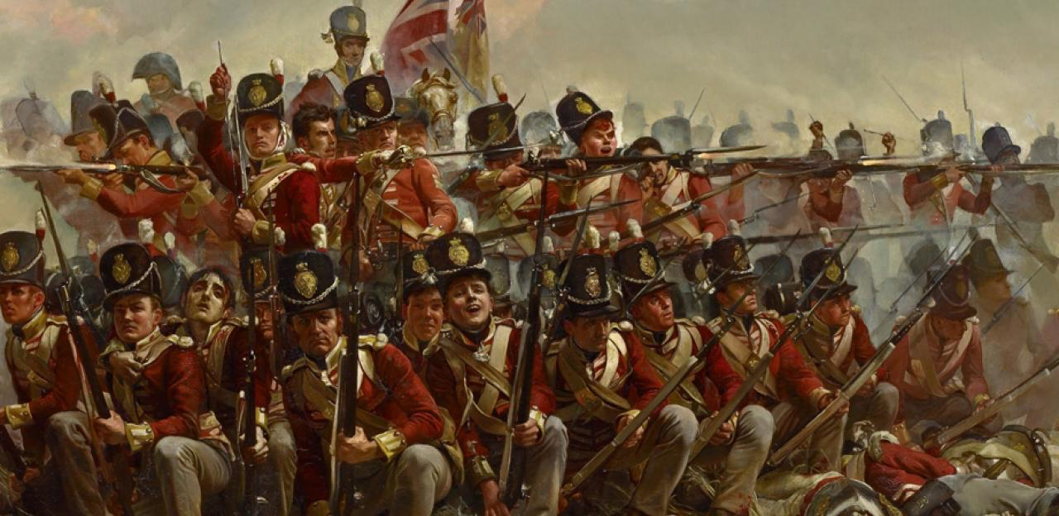
American Revolution 3
Charlie Li

Slide 2
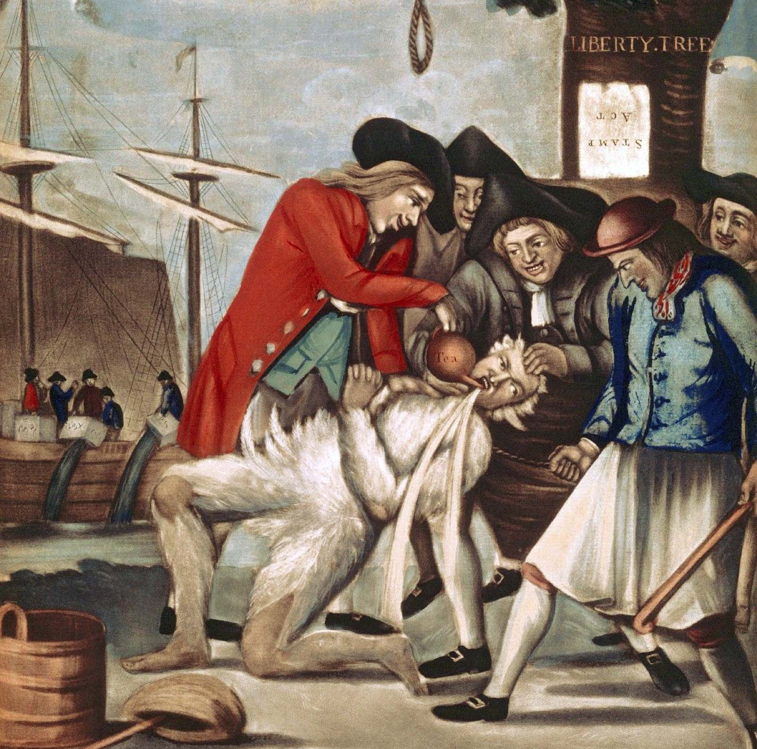
The Nonimportation Agreement
Boycott of British goods
Sons of Liberty
Daughters of Liberty
Tarring and Featuring

Slide 3
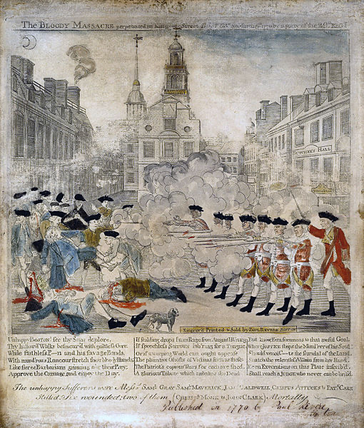
Boston Massacre 1770
Boston, Massachusetts was a hotbed of radical revolutionary thought and activity leading up to 1770.
In March 1770, British soldiers stationed in Boston opened fire on a crowd, killing five townspeople and infuriating locals.
What became known as the Boston Massacre intensified anti-British sentiment and proved a pivotal event leading up to the American Revolution.
In your opinion, was the Boston Massacre truly a massacre? Who do you think was at fault for the incident?

Slide 4
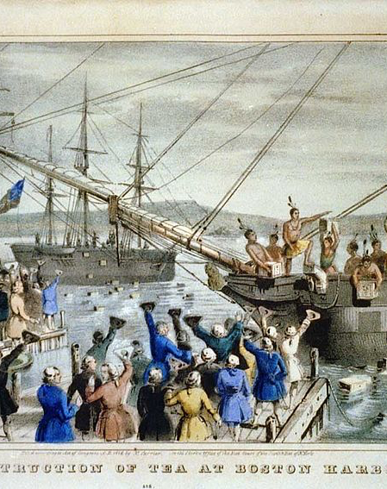
Boston Tea Party 1773
Willful destruction of 342 crates of British tea, proved a significant development on the path to the American Revolution.
Known to contemporaries as the Destruction of the Tea, was a direct response to British taxation policies in the North American colonies.
The British response to the Boston Tea Party was to impose even more stringent policies on the Massachusetts colony. The Coercive Acts levied fines for the destroyed tea, sent British troops to Boston, and rewrote the colonial charter of Massachusetts, giving broadly expanded powers to the royally appointed governor.

Slide 5
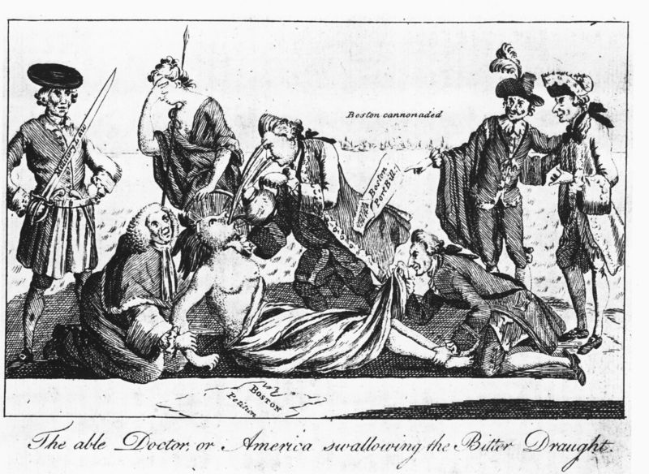
Coercive Acts 1774
Coercive = Intolerable Acts
  Boston Port Bill
  Government Bill
  Administration of Justice Act
  Quartering Act

Slide 6
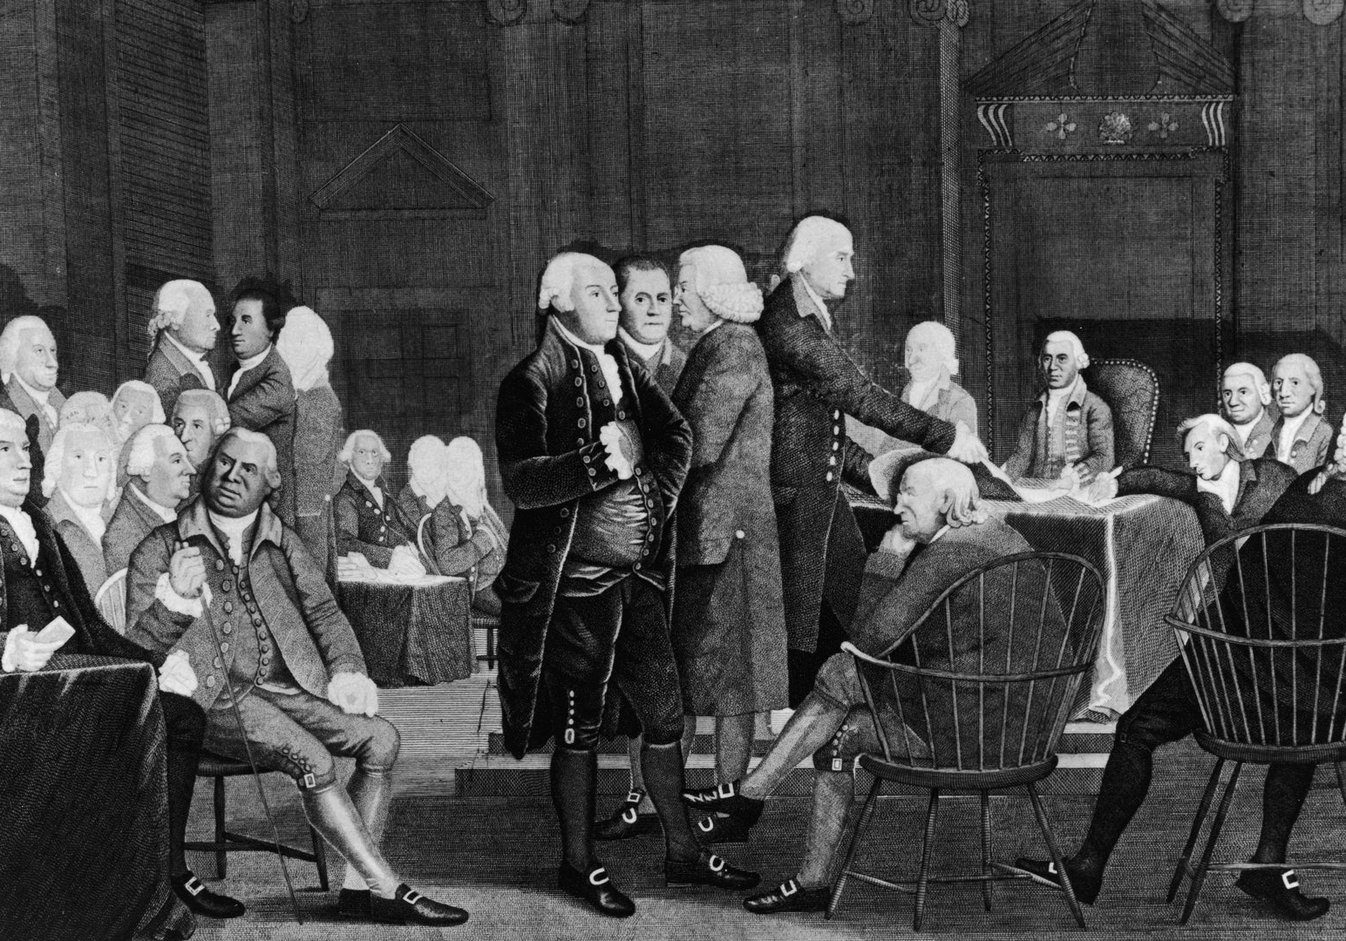
First Continental Congress 1774
1774, Coercive Acts = Intolerable Acts.
Aimed at isolating Boston, the seat of the most radical anti-British sentiment, from the other colonies.
Colonists responded with a show of unity, convening the First Continental Congress to discuss and negotiate a unified approach to the British.
Why do you think the British refused to back down in the face of opposition to its policies?

