Slide 1
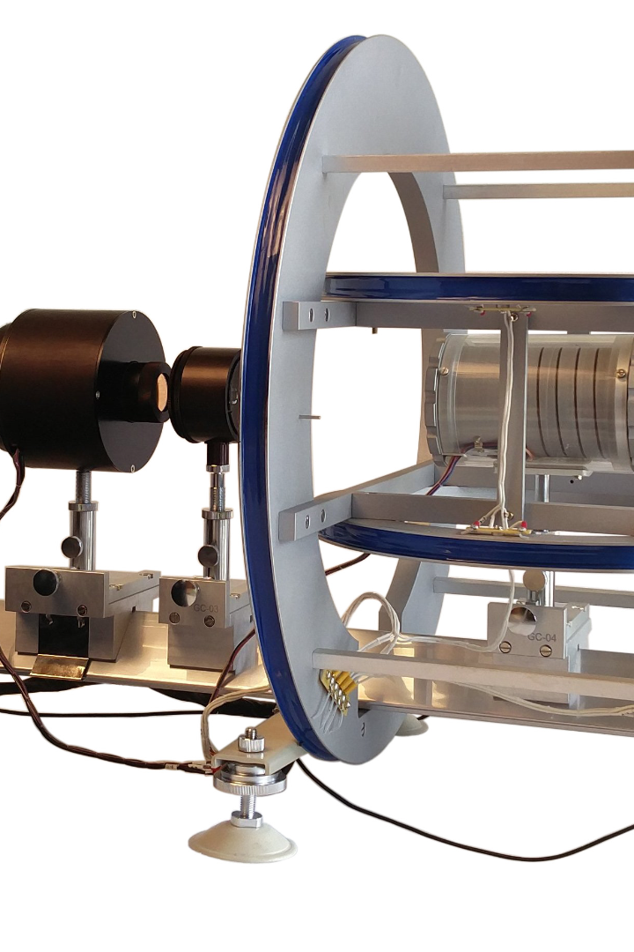
Forces and Pressure
Give me a lever long enough and a fulcrum on which to place it, and I shall move the world
— Archimedes

Slide 2
Review
What are two types of frictions? What is the difference between them?
What is g?
How does the speed of an object changes during free fall?

Slide 3
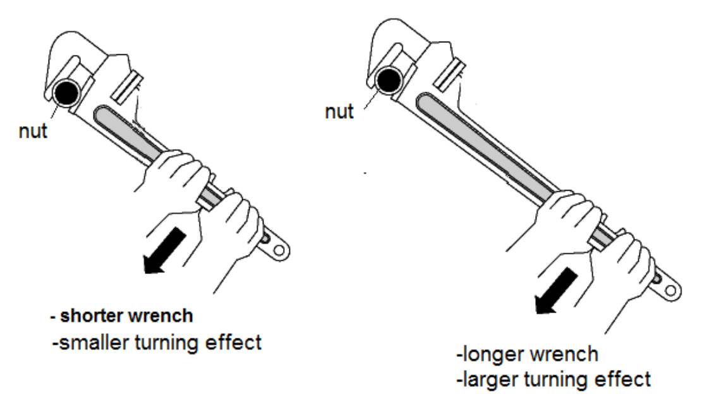
Turning Effect of a Force
Imagine you are tightening a nut.
It is difficult to tighten a nut with your fingers. But with a spanner, you can produce a largr turning effect.
The turning effect of a force is called a moment.
Moment is calculated like this:
moment of a force about a point = force * perpendicular distance from the point
Moments are described as clockwise or anticlockwise, depending on their direction. The moment of a force is called a torque.
Turning a spanner with less force by pushing farther from the pivot.

Slide 4
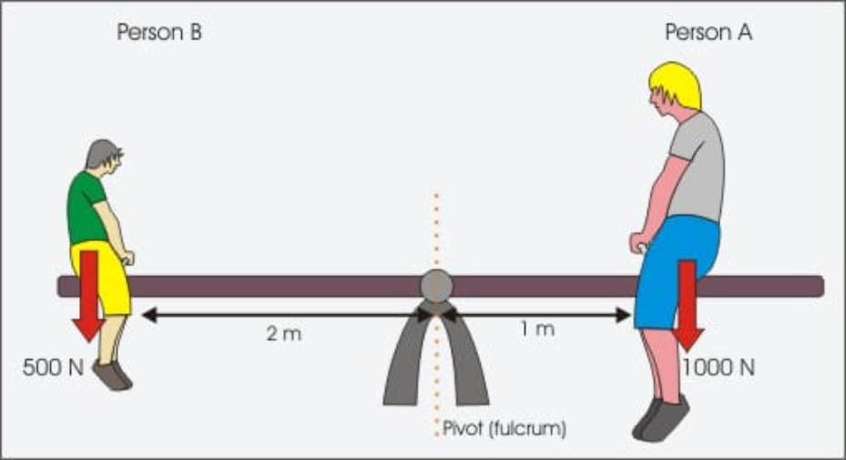
The Principles of Moments
Moment for person B about the pivot: 500N * 2m = 1000 Nm (anticlockwise)
Moment for person A about the pivot: 1000N * 1m = 1000 Nm (clockwise)
Thus, one turning effect balance the other.
This illustrates the principles of moment:
    If an object is in equilibrium: the sum of the clockwise moments about any point is equal to the sum of the anticlockwise moments about that point.
Conditions for equilibrium:
    The sum of the forces in one direction must equal the sum of the forces in the opposite direction.
    The principle of moments must apply.

Slide 5
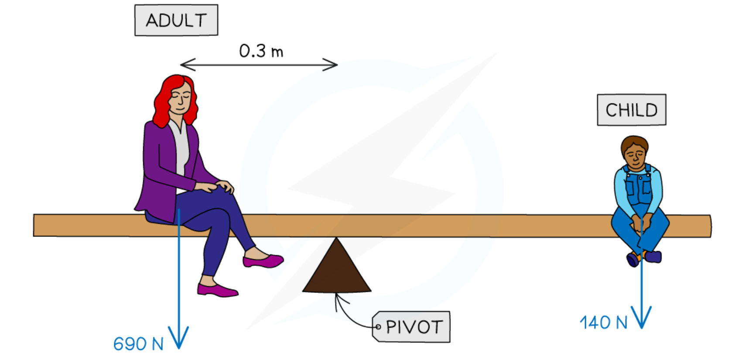
Example
An adult and a child are sitting on two sides of a seesaw. The adult weighs 690 N, and the child weighs 140 N. The distance between the adult and the pivot is 0.3m. The seesaw is in equilibrium.
a. What is the distance between the child and the pivot?
Sum of anticlockwise moments = 690 N * 0.3 m = 207 Nm (anticlockwise)
Sum of clockwise moments = 140 N * X = 140X N (clockwise)
140X N = 207 Nm
X = 207m / 140 = 1.48 m
b. What is the supporting force exerted by the pivot to the seesaw?
Force downwards = Weight of the adult + weight of the child = 690 N + 140 N = 830 N
Supporting force = 830 N

Slide 6
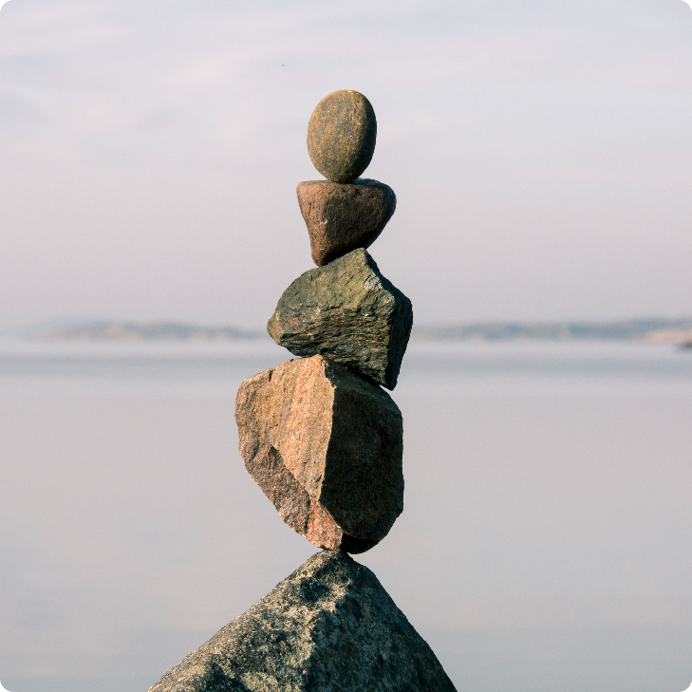
Center of Mass
All objects are made up of lots of tiny particles, each with a small gravitational force on it.
The rocks balance when placed at one particular point, G, because the gravitational forces have turning effects about G which cancel out.
Together, the small gravitational forces act like a single force at G.
G is the center of mass (or center of gravity).

Slide 7
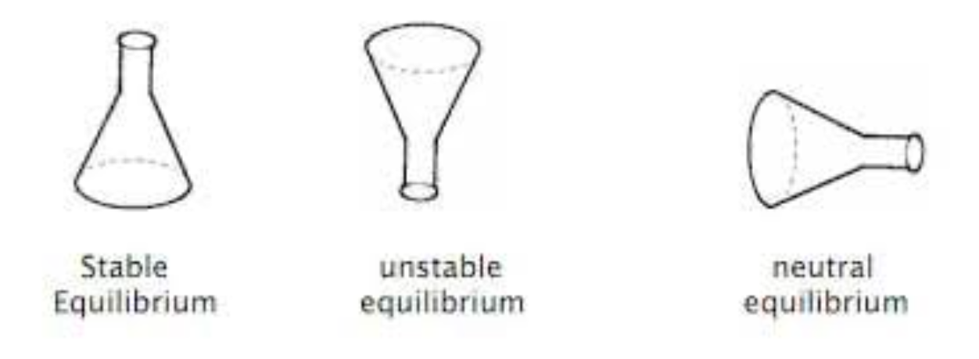
Stability
If a box is pushed a little and then released, it falls back to its original position.
If the box is pushed much further, it topples.
It starts to topple as soon as its center of mass passes over the edge of its base.
States of equilibrium
Stable equilibrium: if you tip the object a little, the center of mass stays over the base.
Unstable equilibrium: if you tip the object a little, the center of mass immediately passes beyond the base.
Neutral equilibrium: the center of mass is always over the base.

Slide 8
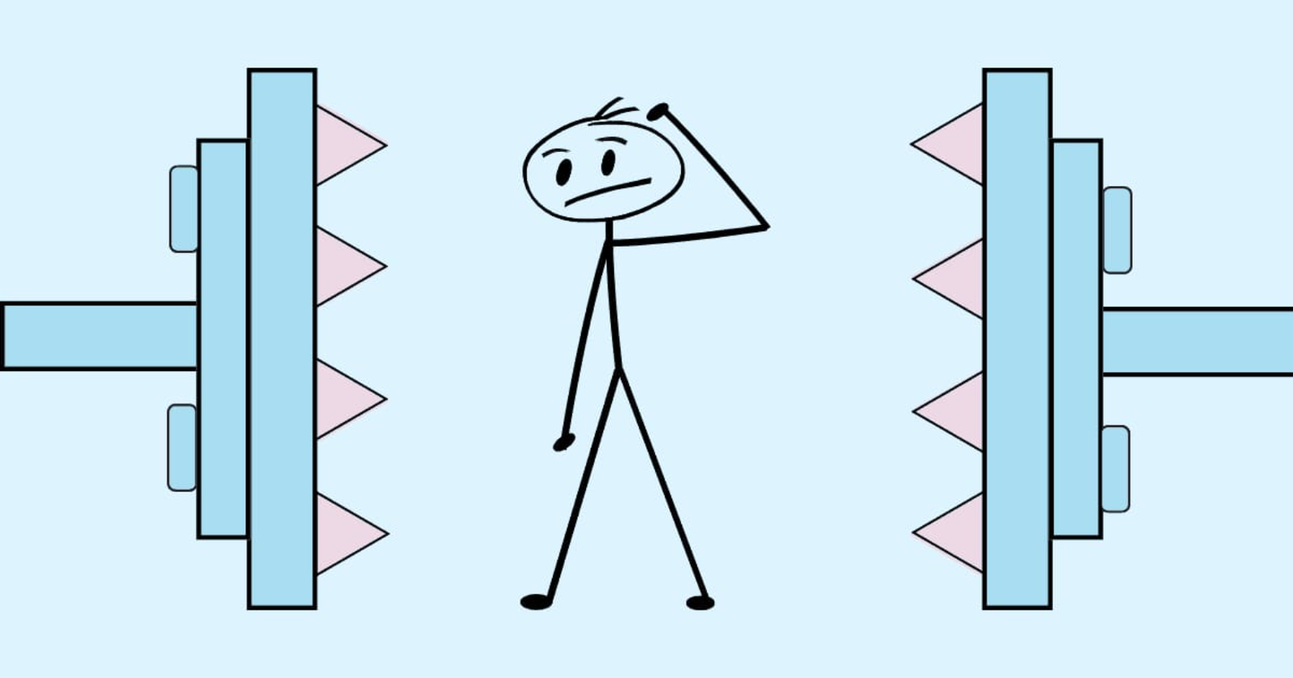
Pressure
Pressure is the force exerted per unit area.
The SI unit for pressure is the pascal (Pa), which is equivalent to one newton per square meter (N/m2).
The equation for pressure is:
  Pressure (P) = Force (F) / Area (A)
In symbols: p = F / A
Pressure can be measured using a variety of instruments, such as barometers, manometers, and pressure gauges.

Slide 9
Applications of pressure
Increasing the pressure by reducing the area
Reducing the pressure by increasing the area
The studs on a football boot have only a small area of contact with the ground. The pressure under the studs is high enough for them to sink into the ground, which gives extra grip.
Skis have a large area to reduce the pressure on the snow so that they do not sink in too far.
Wall foundations have a large horizontal area. This reduces the pressure under neath so that the walls do not sink further into the ground.
The area under the edge of a knife's blade is extremely small. Beneath it, the pressure is high enough for the blade to push easily through the material.

Slide 10
Practice
The wind pressure on the wall is 100 Pa. If the wall has an area of 6 m², what is the force on it?
A concrete block has a mass of 2600 kg. If the block measures 0.5 m by 1.0 m by 2.0m, what is the maximum pressure it can exert when resting on the ground? (g = 10 N/kg)
Pressure = Force / Area

Slide 11
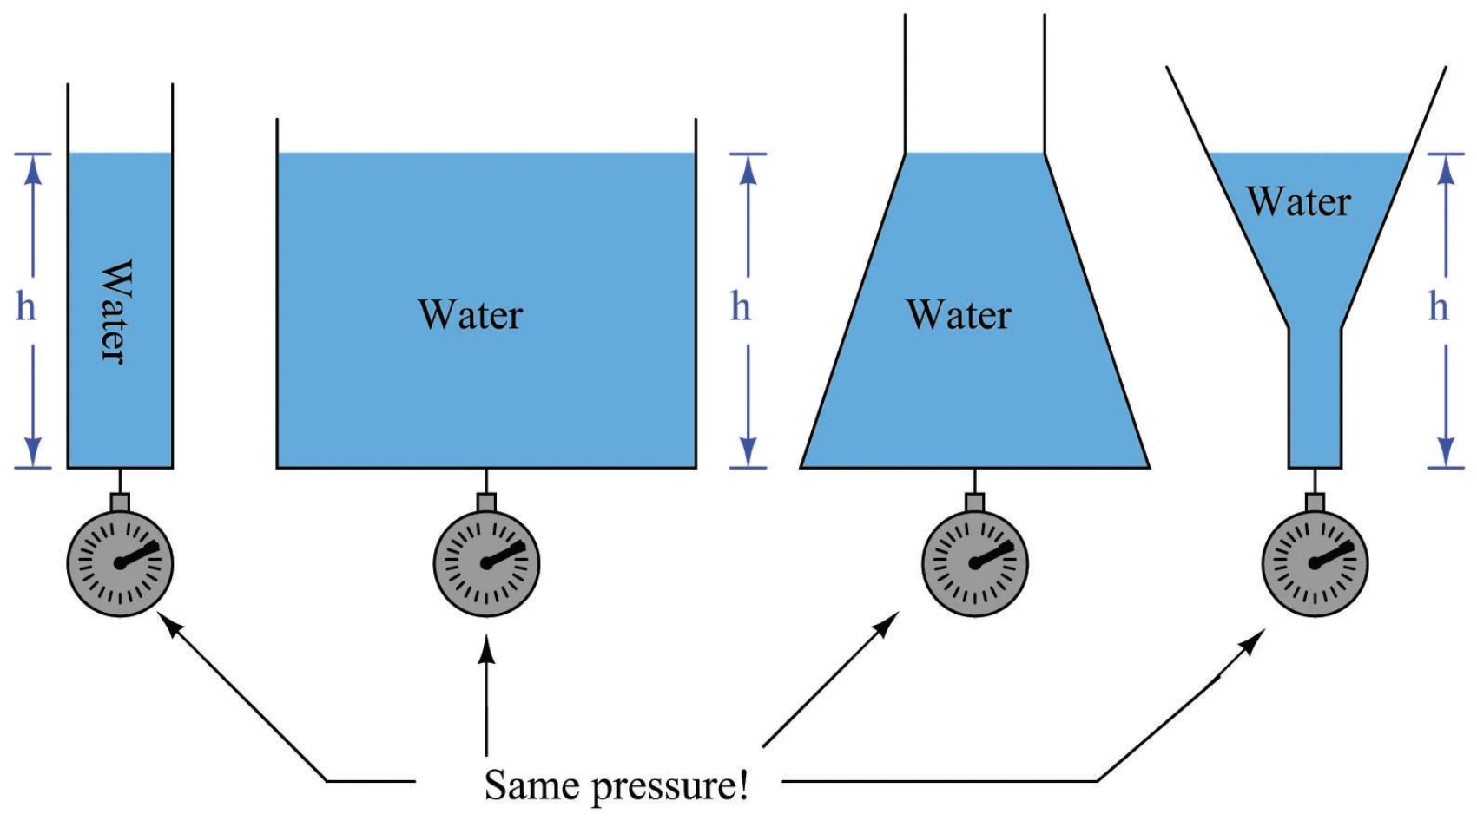
Pressure in Liquids
When a liquid is at rest, each layer of the liquid applies a pressure on the layer below it due to the weight of the liquid above. This pressure is called hydrostatic pressure.
Some of the main features of hydrostatic pressure:
    pressure acts in all directions
    pressure increases with depth
    pressure increases with the density of the liquid
    pressure doesn't depend on the shape of the container
The hydrostatic pressure at any point in a liquid is given by:
  Hydrostatic Pressure = Density of liquid × Acceleration due to gravity × Depth
  In symbols: P = ρgh

Slide 12
Example
If the density of water is 1000 kg/m³, what is the pressure due to the water at the bottom of a swimming pool 2 m deep?
pressure = ρgh = 1000 kg/m³ 10 N/kg * 2 m = 20000 Pa

Slide 13
Conclusion and Review
Key Concepts:
Equations:
Takeaways:
Turning effect of a force
Center of mass
Balance and equilibrium
Pressure
Hydrostatic pressure
Forces can cause objects to rotate around a pivot point, known as the turning effect of a force.
moment = force x perpendicular distance from pivot
pressure = force/area
The center of mass is the point where an object's weight is evenly distributed in all directions.
Objects are stable when their center of mass is located above their base of support.
Pressure is the amount of force exerted per unit area. It can be calculated using the equation pressure = force/area.

Slide 14
Practice
A uniform meter rule has a weight of W. It is pivoted at the 75 cm mark and balanced by a force of 2 N acting at the 95 cm mark.
Calculate the moment of the 2 N force about the pivot.
b. Use the principle of moments to calculate the value of W in newtons.

Slide 15
Practice
A earth-moving vehicle uses a special type of tyre.
a. When the vehicle is loaded, the area of each tyre in contact with the ground is a rectangle of sides 1.0 m and 0.5 m.
i. Calculate the area is m² of contact of one tyre with the ground.
ii. The vehicle has four of these tyres. Calculate the total area in m² of contact with the ground.
b. When the vehicle is loaded, it weighs 100 000 N. Calculate the pressure in N/m² exerted on the ground by the tyres.

Slide 16
Practice
A rectangular storage tank has a base measuring 3 m by 2m. The tank is filled with water to a depth of 2 m. The density of the water is 1000 kg/m³, g is 10 N/kg. Calculate:
a. The volume of water in the tank.
b. The mass of water in the tank.
c. The weight of water in the tank (in N).
d. The pressure at the bottom of the tank.

