Slide 1

Bright Beginnings
Welcome to Spark Lab: Unleash Your Electric Ingenuity
Mike yu

Slide 2




Content
Circuits, Conductors, Switches
Self-Intro
Course Syllabus
Real-Life Applications

Slide 3
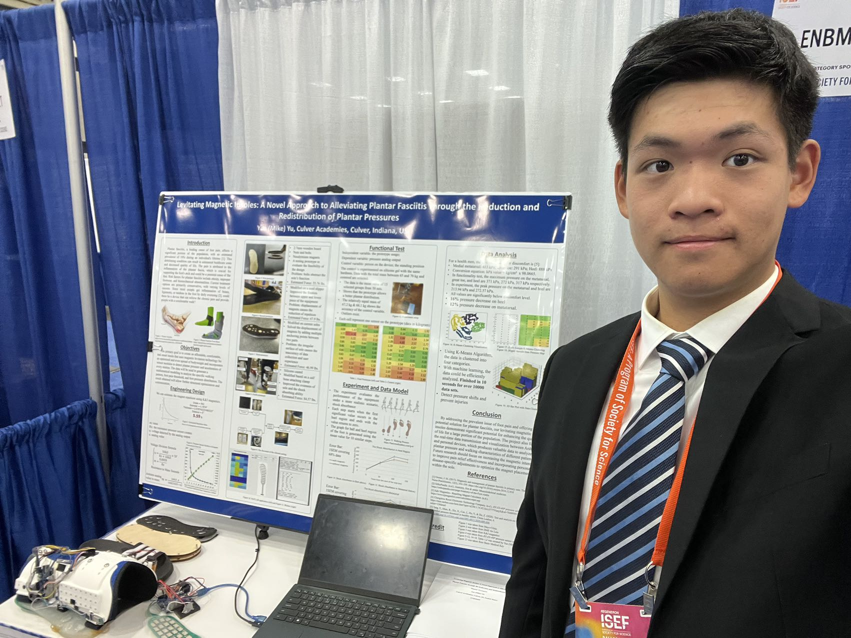
Self Introduction
Culver Academies 2024
Shanghai, China
Biomedical Engineering & ISEF

Slide 4

Course Syllabus
Camera on
Ask questions and actively seek help.
An Engineering Notebook exclusively for this class.
Pen and pencil for sketching.
WeChat group
Questions?

Slide 5
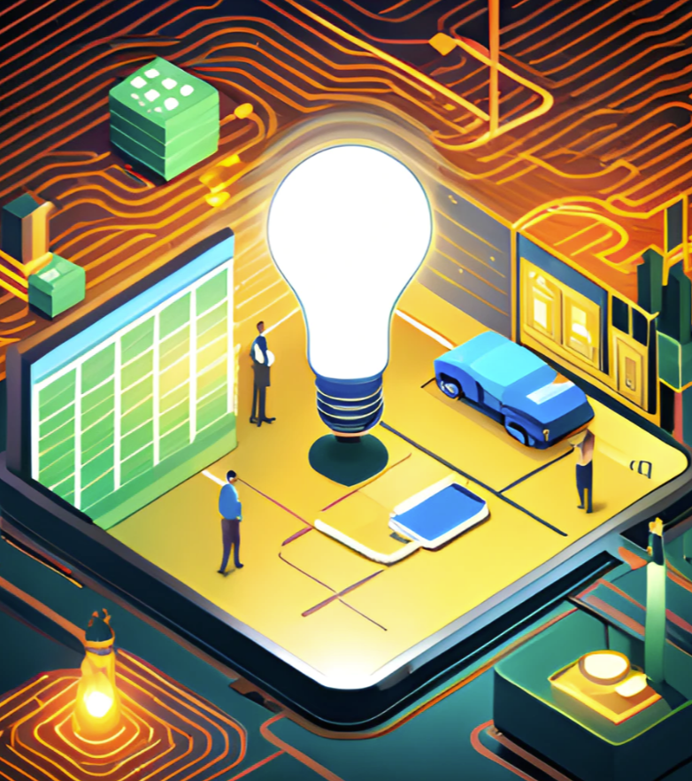
Electrical Engineering
What is Electrical Engineering?
Electrical engineering is an engineering discipline concerned with the study, design, and application of equipment, devices, and systems which use electricity, electronics, and electromagnetism.
- Wikipedia

Slide 6



Real World Application
What is a world like without electrical engineering?

Slide 7
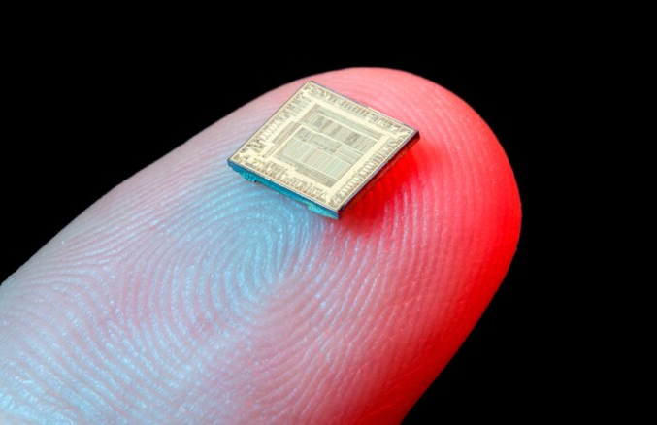
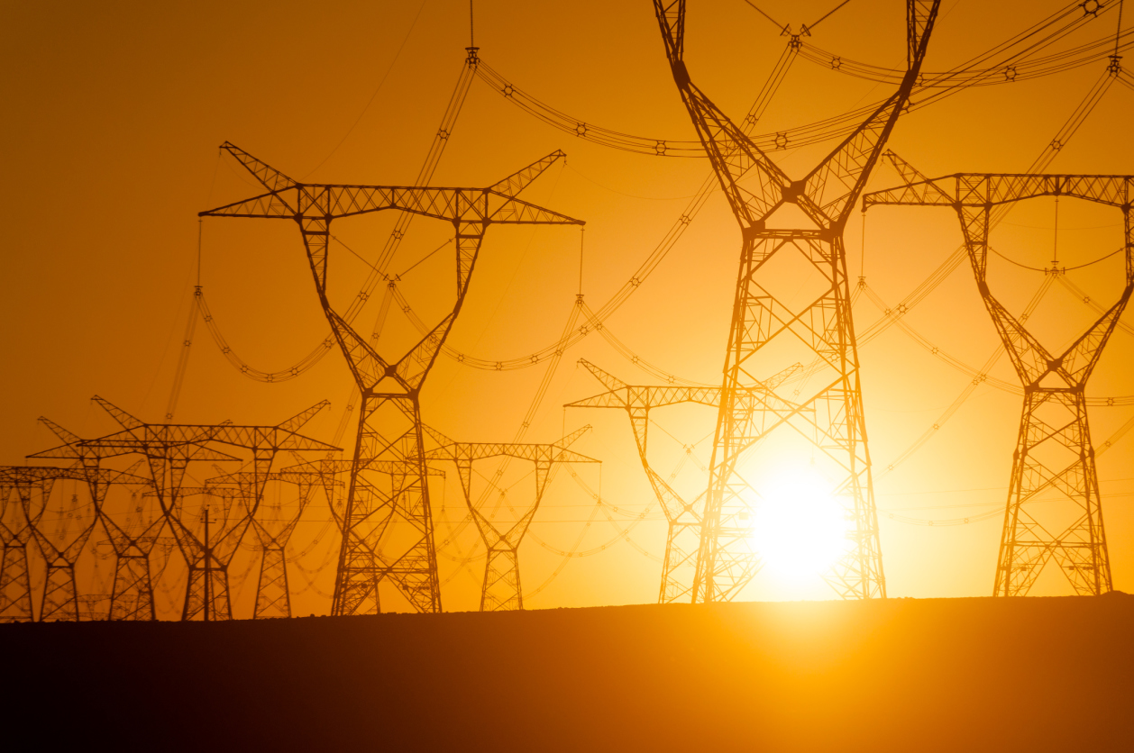
The Wide realm of Electrical engineering

Slide 8
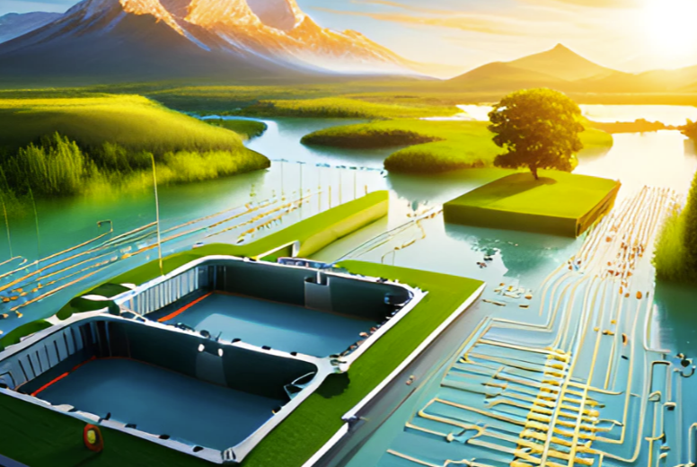
Connection with other subjects
Electrical Engineering relates to:
Energy science: requires technology to generate renewable resources.
Computer science: computer processors requires electrical signals for calculation
Physics: requires equipment to study particles and measure datasets
Mechanical Engineering: the physical & material side of design

Slide 9

Electrical Engineering
Circuit
Conductors
Switches

Slide 10
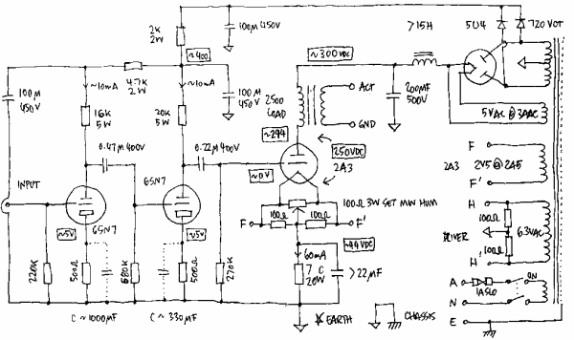
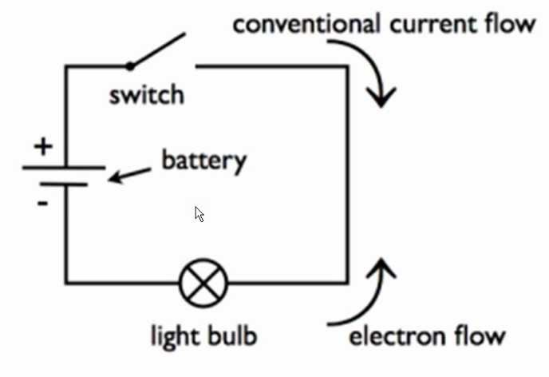
Circuit
A circuit is a closed loop through which electricity can flow. It consists of a power source, wires, and electrical components.
Circuit diagrams

Slide 11
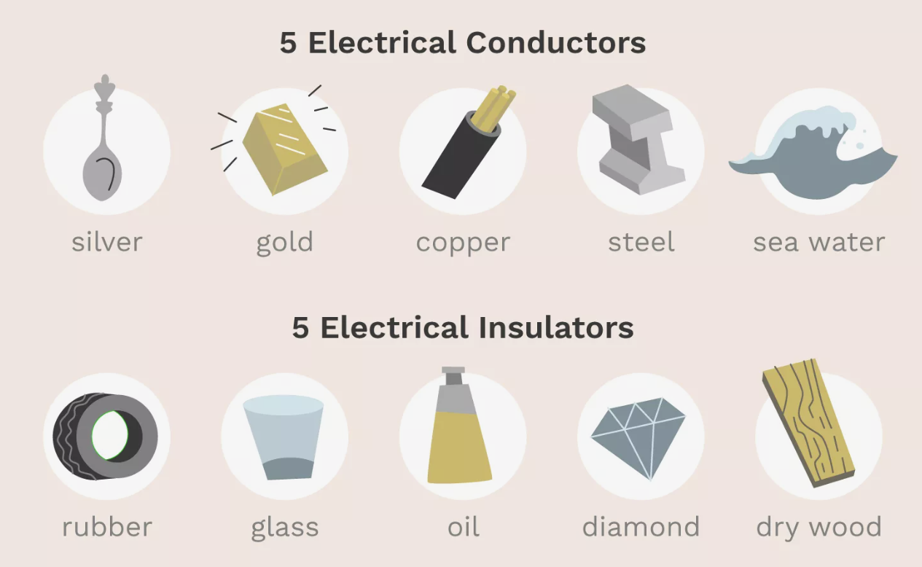
Conductors
Conductors are materials that allow electricity to flow through them easily, while insulators are materials that do not allow electricity to flow through them easily.
Conductors: metals such as copper and aluminum
Insulators: rubber, plastic

Slide 12
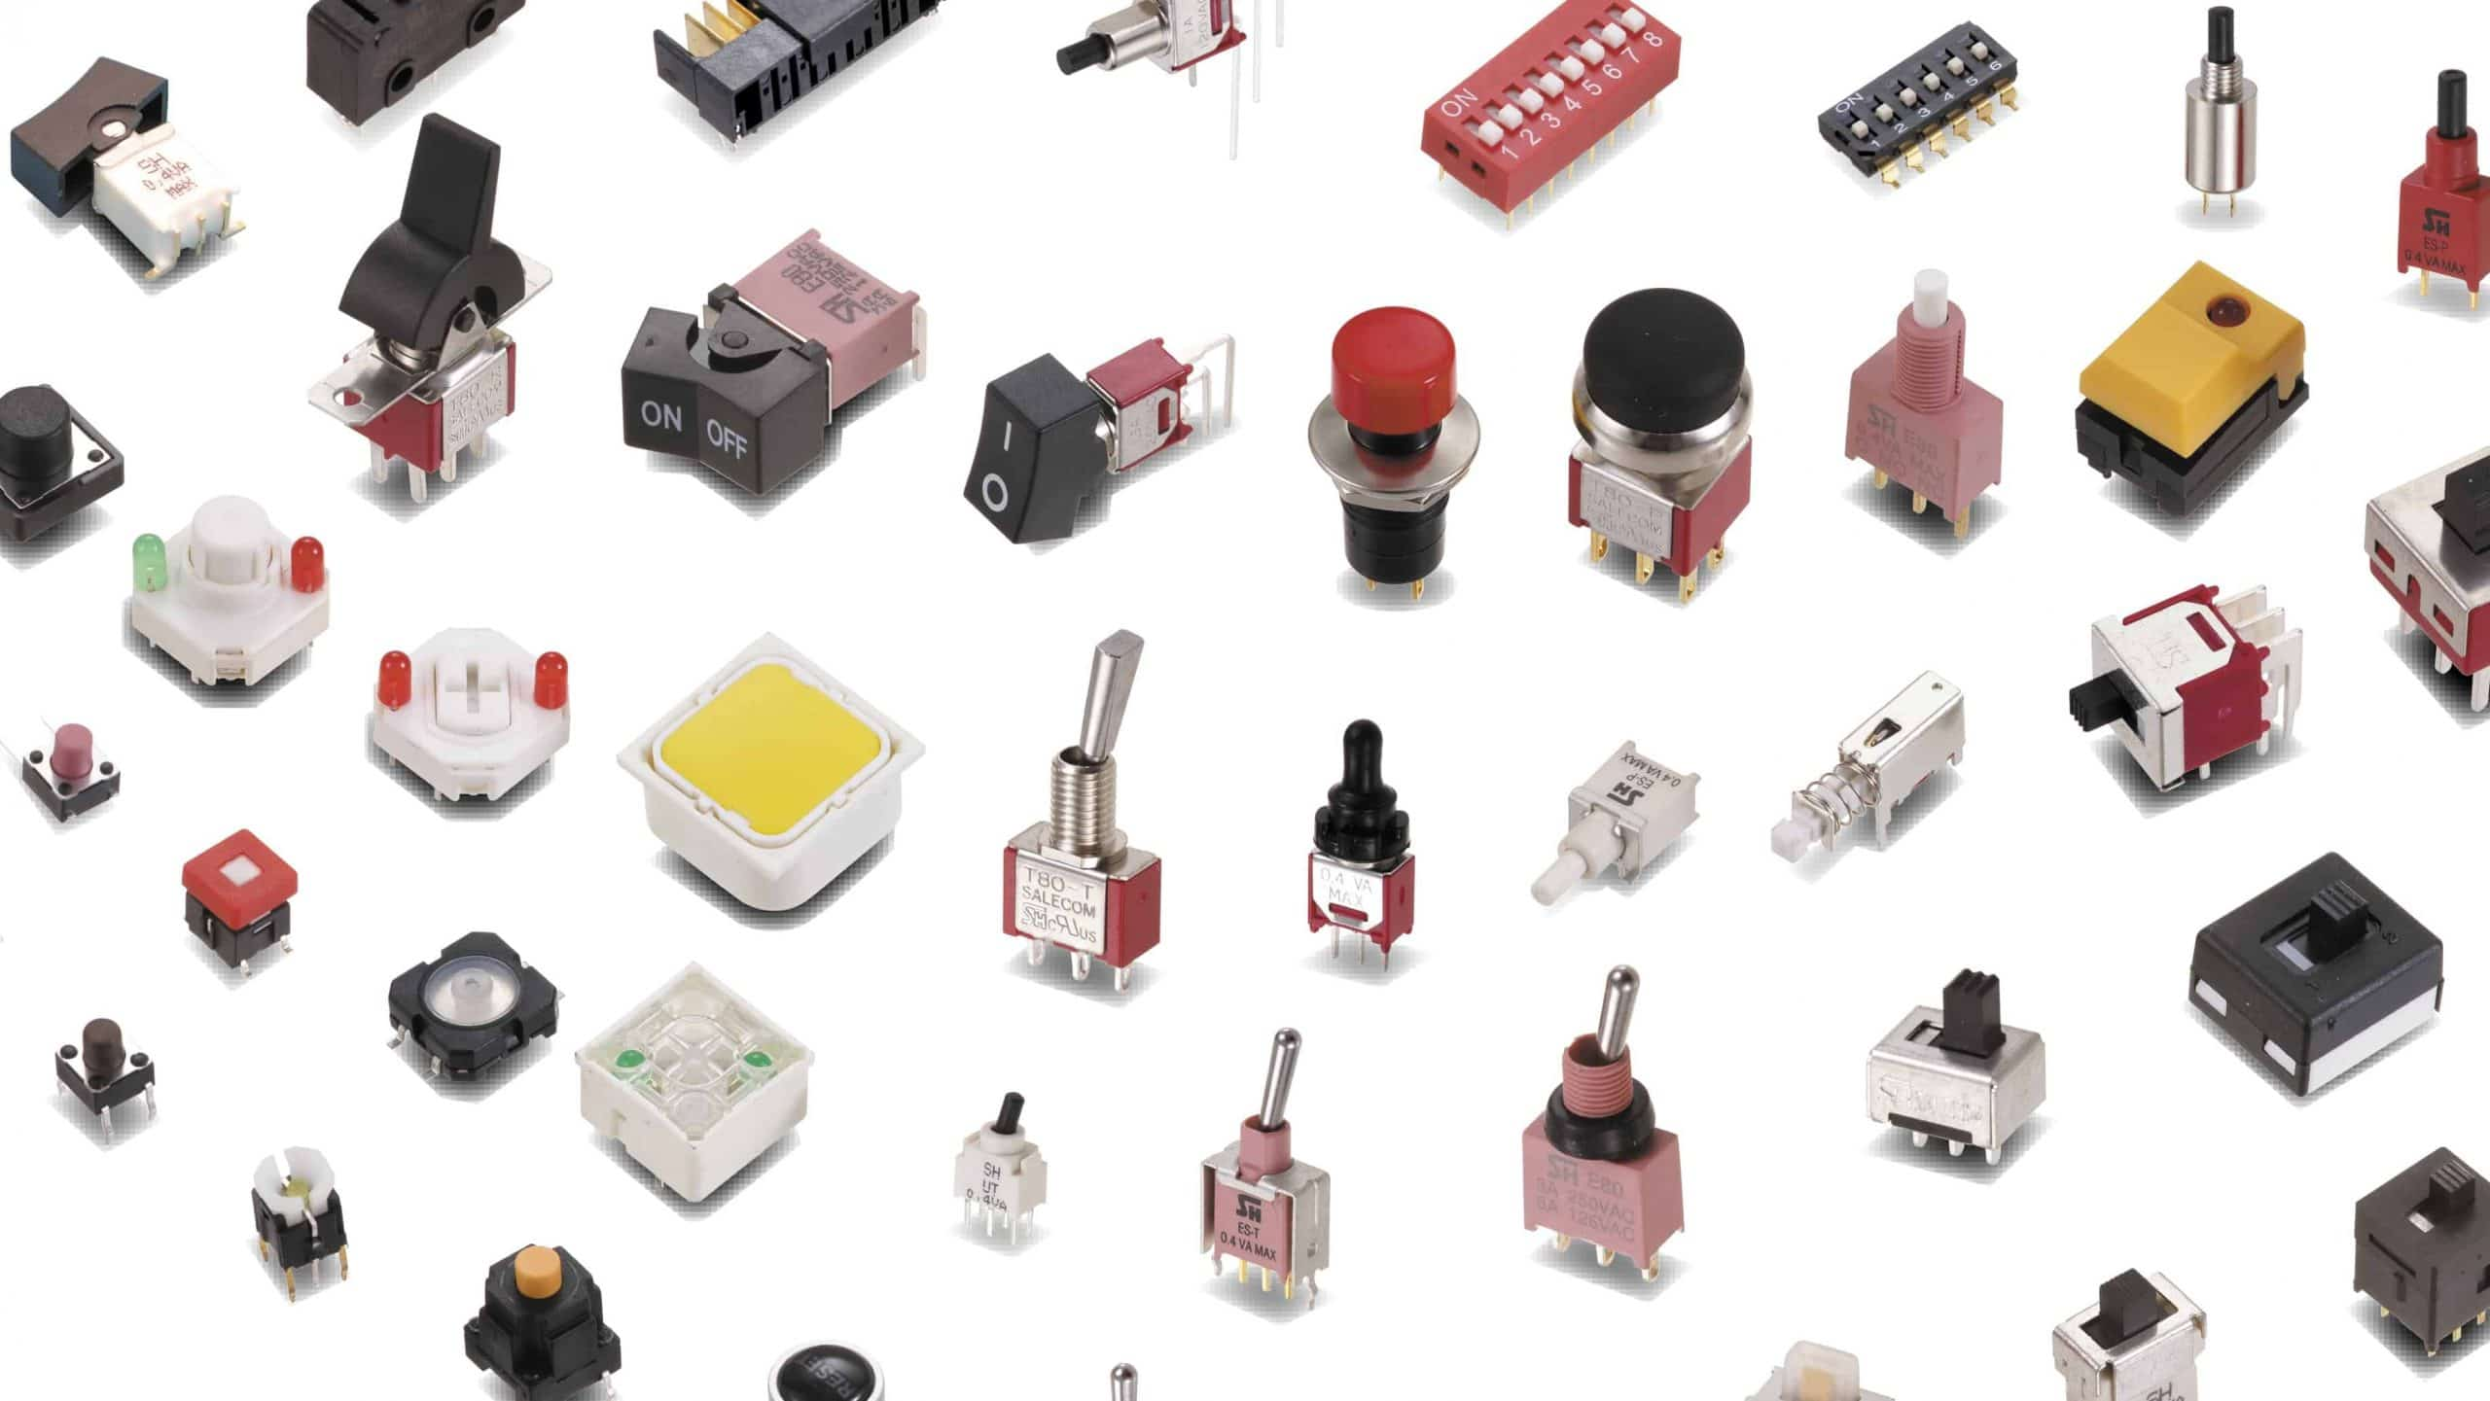
Switches
A switch is a device that controls the flow of electricity in a circuit. It can be used to turn a circuit on or off, to divert the flow of electricity.
Types of switches: toggle switches, push-button switches, and rotary switches

Slide 13
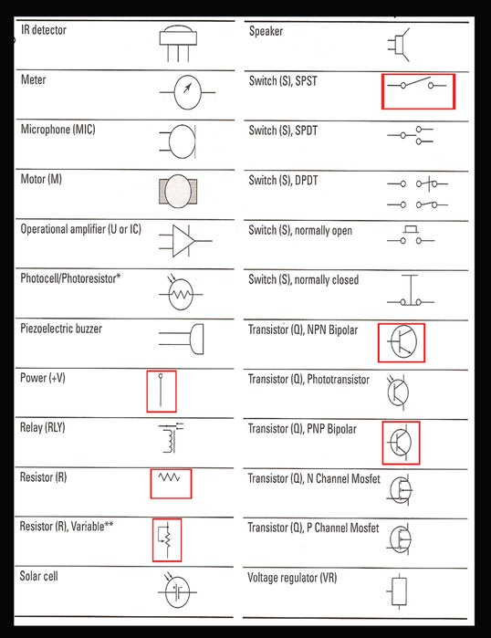
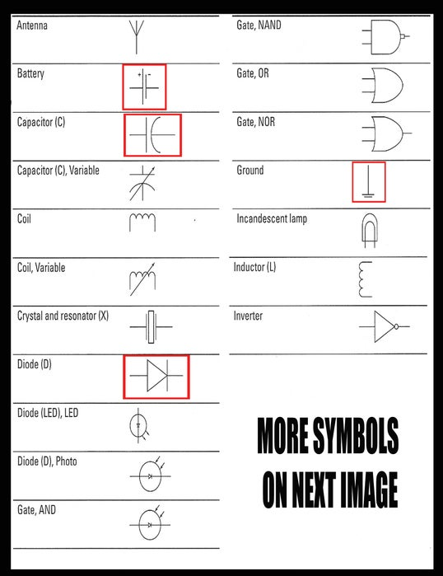
How to draw a circuit of a fan that has a battery, a switch, and a motor?

Slide 14
Creating your controllable circuit
https://phet.colorado.edu/sims/html/circuit-construction-kit-dc/latest/circuit-construction-kit-dc_all.html
Go to intro and construct a circuit that can be controlled.

Slide 15

HW
Finish your controllable circuit
Submit a screenshot of your circuit

