Slide 1

Sparking Innovation
Spark Lab: Unleash Your Electric Ingenuity
Mike yu

Slide 2


Contend
Project
Arduino Simulator
Winner of Scavenger Hunt will be announced tomorrow

Slide 3

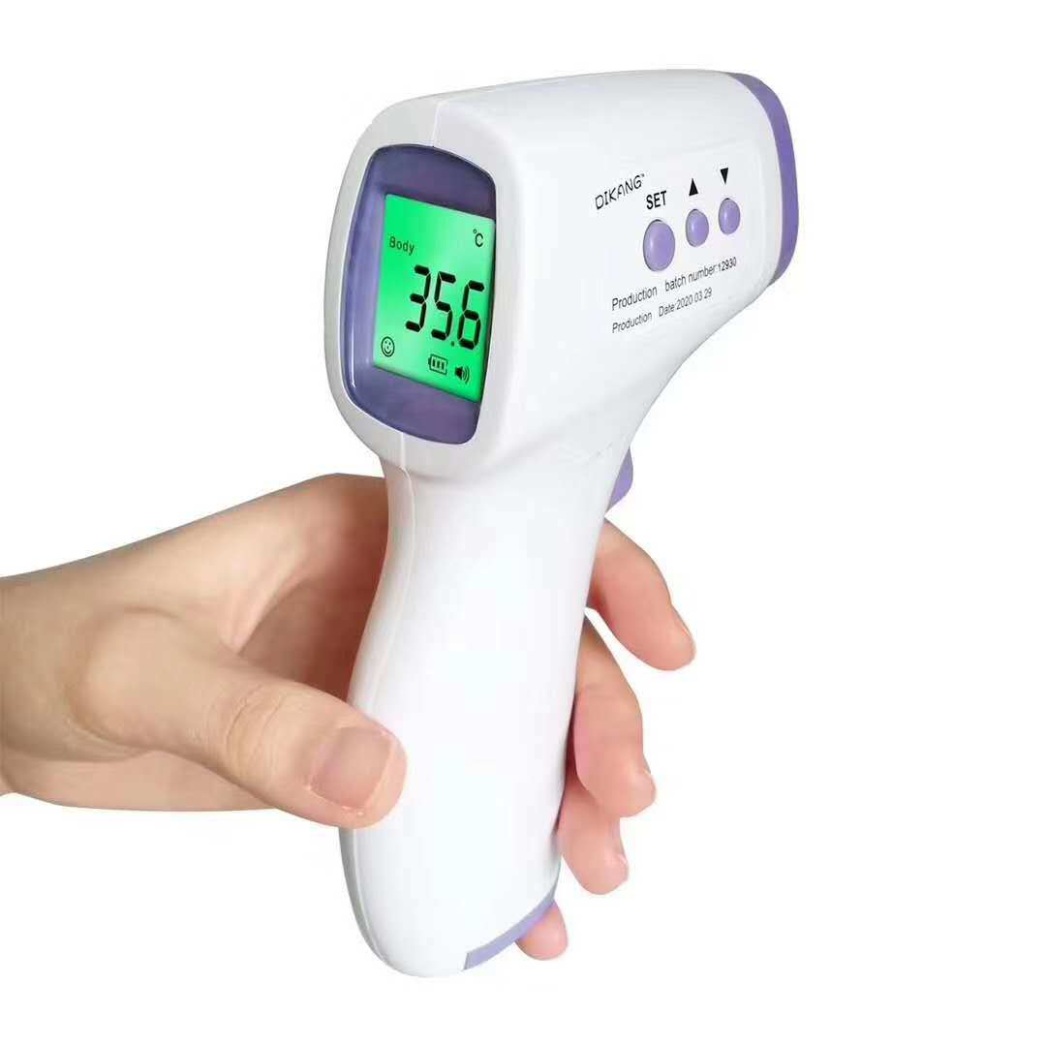
Project
Create an electrical device that can benefit the living condition of the user and improve the life quality.
The limitation is your imagination
Create the prototype via Arduino Simulator
Provide a sketch of the circuit diagram
Required Material by the end of the course:
  PowerPoint
  Presentation
  Circuit Diagram
  Prototype

Slide 4
PowerPoint Required Slides
Abstract: a paragraph summary of the work you did. In 150 to 200 words, write the purpose of work, what question are you trying to address with the prototype, method to produce your prototype, result of your project.
Introduction: In this section you want to inform the reader of the reason(s) for your research, explain the reason for your study, briefly describe how you carried out the research and your conclusion.
Materials and Methods: all the material and electrical component utilized, the circuit drawing, the circuit connection, what is the code for the Arduino Board.
Results: the full function of prototype and user scenario
Conclusion: what device did you create, why is it important, what will do different if you can do it again
Acknowledgement: gratify the person helped you to do the project

Slide 5
Calendar
Mon | Tue | Wes | Thu | Fri | Sat | Sun
Class | Class | Class | Class | Today | Research Question Due
Literature Review Done |  | Prototype Completed |  | PowerPoint Completed & Presentation

Slide 6
Research
Identify the Research Problem: Define the specific engineering problem or question that you want to address through your research. Clearly articulate the objectives and scope of your research.
Literature Review: Conduct a thorough review of existing literature, research papers, patents, and other relevant sources to gain an understanding of the current state of knowledge in your field of research. This will help you identify existing theories, methodologies, and gaps in knowledge that your research can contribute to.
Formulate the design: Based on your understanding of the existing knowledge, formulate design that you aim to solve the question. These should be aligned with your research problem.
Example:
Weather detection

Slide 7
Arduino Simulator Demo
I will be creating a smart thermometer

Slide 8

HW
Work on the project

