Slide 1
Psychology and life
Session 7: Intro to Psychology
Lillian Liao Culver Academies

Slide 2
Major theories for personality
Biological Theories of Personality
Behavioral Theories of Personality
Psychodynamic Theories of Personality
Humanist Theories of Personality
Trait Theories of Personality

Slide 3
Major theories for personality
Biological Theories of Personality (Nature)
Behavioral Theories of Personality (Nurture)
Psychodynamic Theories of Personality
Humanist Theories of Personality
Trait Theories of Personality

Slide 4
The nature nurture debate
Nature: refers to how genetics influence the personality
Nurture: refers to how the environment impacts our development

Slide 5
Nature
Some philosophers, such as Plato (柏拉图) and Descartes (笛卡尔), suggested that certain factors are inborn or occur naturally regardless of environmental influences
Based on the theory of evolution
The believe that genetic traits are handed down from parents to their children and is what makes each individual unique.

Slide 6
Nurture
John Locke, believed in what is known as tabula rasa which suggests that the mind begins as a blank slate
Everything that we are is determined by our experiences
Behaviorism is a good example of a theory rooted in this belief as behaviorists feel that all actions and behaviors are the results of conditioning

Slide 7
Major theories for personality
Biological Theories of Personality
Behavioral Theories of Personality
Psychodynamic Theories of Personality
Humanist Theories of Personality
Trait Theories of Personality

Slide 8
Psychodynamic Theories of Personality
Psychodynamic theories includes:
Freud's psychosexual stage theory
Erik Erikson's stages of psychosocial development

Slide 9
psychosexual stage theory
According to Freud, children go through a series of psychosexual stages that lead to the development of the adult personality
Freud believed that personality developed through a series of childhood stages in which the pleasure-seeking energies of the id become focused on certain erogenous areas
(erogenous zone is characterized as an area of the body that is particularly sensitive to stimulation)

Slide 10
Psychodynamic Theories of Personality
Psychodynamic theories includes:
Freud's psychosexual stage theory
Erik Erikson's stages of psychosocial development

Slide 11
psychosexual stage theory
The 5 stages are: the oral, anal, phallic, latent, and genital
The erogenous zone associated with each stage serves as a source of pleasure for the id
Each stage of development is marked by conflicts that can help build growth depending upon how they are resolved
If these psychosexual stages are completed successfully, a healthy personality is the result
A fixation is a persistent focus on an earlier psychosexual stage. Until this conflict is resolved, the individual will remain "stuck" in this stage

Slide 12
Stage 1:
The oral stage
Age Range: Birth to 1 Year
Erogenous Zone: Mouth

Slide 13
Stage 1:
The oral stage
During the oral stage, the infant's primary source of interaction occurs through the mouth
The mouth is vital for eating, and the infant derives pleasure from oral stimulation through gratifying activities such as tasting and sucking
Because the infant is entirely dependent upon caretakers (who are responsible for feeding the child), the child also develops a sense of trust and comfort through this oral stimulation
The primary conflict at this stage is to become less dependent upon caretakers.

Slide 14
Stage 2:
The Anal stage
Age Range: 1-3 Years old
Erogenous Zone: Bowel and Bladder Control

Slide 15
Stage 2:
The Anal stage
During the anal stage, Freud believed that the primary focus is on controlling bladder and bowel movements
The major conflict at this stage is toilet training—the child has to learn to control their bodily needs
Developing this control leads to a sense of accomplishment and independence
Freud believed that positive experiences during the toilet training stage serve as the basis for people to become competent, productive, and creative adults

Slide 16
Stage 3:
The phallic stage
Age Range: 3-6 Years old
Erogenous Zone: Genitals

Slide 17
Stage 3:
The Phallic stage
During the phallic stage, the primary focus is on the genitals. At this age, children also begin to discover the differences between males and females
During this stage females would develop envy and males would develop anxiety

Slide 18
Stage 4:
The latent stage
Age Range: 6 Years old to puberty
Erogenous Zone: Sexual Feelings

Slide 19
Stage 4:
The latent stage
During this stage, the superego continues to develop while the id's energies are suppressed
Children develop social skills, values, and relationships with peers and adults outside of the family
This period is a time in which the sexual energy is repressed. This energy is still present, but it is covered by other areas such as intellectual pursuits and social interactions
This stage is important in the development of social and communication skills and self-confidence

Slide 20
Stage 5:
The genital stage
Age Range: puberty to death
Erogenous Zone: Maturing sexual interest

Slide 21
Stage 5:
The genital stage
During the final stage of psychosexual development, the individual develops a strong sexual interest in the opposite sex
Freud believed that the ego and superego were fully formed and functioning at this point

Slide 22
psychosocial development theory
Erik Erikson theory centered on psychosocial development rather than psychosexual development
His theory focused on how social interaction and relationships played a role in the development and growth of human beings
Erikson's theory was based on what is known as the epigenetic principle
(people grow in a sequence that occurs over time and in the context of a larger community)

Slide 23
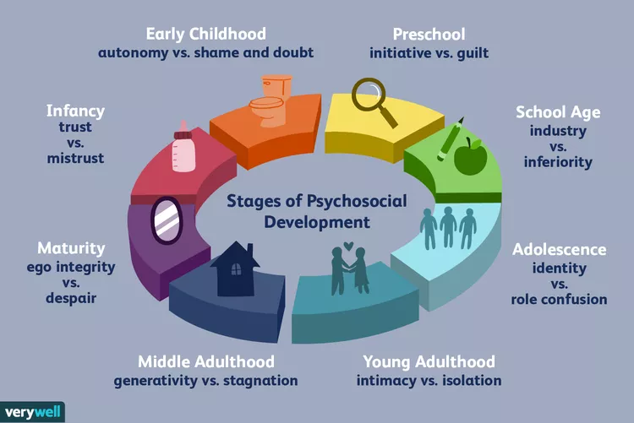
psychosocial development theory

Slide 24
psychosocial development theory
(Conflict during each stage)
In each stage, Erikson believed people experience a conflict that serves as a turning point in development
These conflicts are centered on either developing a psychological quality or failing to develop that quality
If people successfully deal with the conflict, they come out from the stage with strengths that will serve them well for the rest of their lives.
If they fail to deal effectively with these conflicts, they may not develop the essential skills needed for a strong sense of self.

Slide 25
Stage 1: Trust vs. Mistrust
Between birth and 1 year of age and is the most fundamental stage in life
At this point in development, the child is dependent upon adult caregivers for everything they need to survive including food, love, warmth, safety, and nurturing
During the first stage of psychosocial development, children develop a sense of trust when caregivers provide reliability, care, and affection. A lack of this will lead to mistrust
No child is going to develop a sense of 100% trust, or 100% doubt. Erikson believed that successful development was all about having a balance between the two opposing sides
When there is a correct balance, children acquire hope, which Erikson described as an openness to experience tempered by some caution that danger may be present.

Slide 26
Stage 2: Autonomy vs. Shame and Doubt
Early childhood
Focused on children developing a greater sense of personal control
At this point in development, children are just starting to gain a little independence. They are starting to perform basic actions on their own and making simple decisions about what they prefer.
By allowing kids to make choices and gain control, parents and caregivers can help children develop a sense of autonomy (自主)
Success during this stage of psychosocial development leads to feelings of autonomy; failure results in feelings of shame and doubt

Slide 27
Stage 3: Initiative vs. Guilt
Preschool years
At this point, children begin to assert their power and control over the world through directing play and other social interactions
Children who are successful at this stage feel capable and able to lead others. Those who fail to acquire these skills are left with a sense of guilt, self-doubt, and lack of initiative
Success in this stage leads to a sense of purpose. Children who try to exert too much power experience disapproval, resulting in a sense of guilt

Slide 28
Stage 4: Industry vs. Inferiority
Early school years from approximately ages 5 to 11
Through social interactions, children begin to develop a sense of pride in their accomplishments and abilities
Children need to cope with new social and academic demands
Children who are encouraged by parents and teachers develop a feeling of competence and belief in their skills. Those who receive little or no encouragement from parents, teachers, or peers will doubt their abilities to be successful
Success leads to a sense of competence, while failure results in feelings of inferiority

Slide 29
Stage 5: Identity vs. Confusion
Teenage years
This stage plays an essential role in developing a sense of personal identity which will continue to influence behavior and development for the rest of a person's life
Those who receive proper encouragement and reinforcement through personal exploration will emerge from this stage with a strong sense of self and feelings of independence and control. Those who remain unsure of their beliefs and desires will feel insecure and confused about themselves and the future
Our sense of personal identity is shaped by our experiences and interactions with others, and it is this identity that helps guide our actions, beliefs, and behaviors as we age

Slide 30
Stage 6: Intimacy vs. Isolation
Early adulthood
Young adults need to form intimate, loving relationships with other people. Success leads to strong relationships, while failure results in loneliness and isolation.
Remember that each step builds on skills learned in previous steps
Erikson believed that a strong sense of personal identity was important for developing intimate relationships
Studies have demonstrated that those with a poor sense of self tend to have less committed relationships and are more likely to struggler with emotional isolation, loneliness, and depression
Love is the virtue achieved when this stage is handled successfully.

Slide 31
Stage 7: Generativity vs. Stagnation
Adulthood
Adults need to create or nurture things that will outlast them, often by having children or creating a positive change that benefits other people.
During adulthood, we continue to build our lives, focusing on our career and family. Those who are successful during this phase will feel that they are contributing to the world by being active in their home and community. Those who fail to attain this skill will feel unproductive and uninvolved in the world.
Care is the virtue achieved when this stage is handled successfully.

Slide 32
Stage 8: Integrity vs. Despair
The final stage occurs during old age and is focused on reflecting back on life
At this stage, people would look back on the events of their lives and determine if they are happy with the life that they lived or if they regret the things they did or didn't do
Those who look back on a life and feel well-lived will be satisfied and ready to face the end of their lives with a sense of peace. Those who look back and only feel regret will instead feel fearful that their lives will end without accomplishing
Success at this stage leads to feelings of wisdom, while failure results in regret, bitterness, and despair

Slide 33
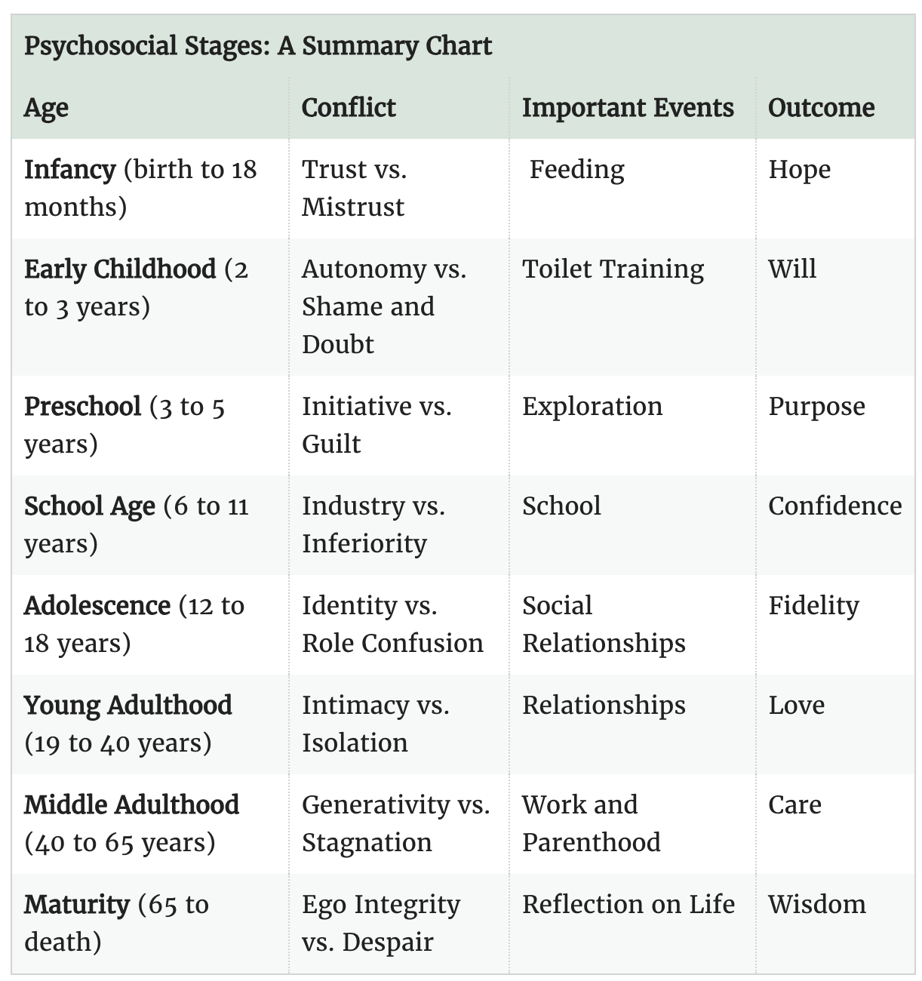
psychosocial development theory

Slide 34

Survey time!!!

