Slide 1
Psychology and life
Session 2: Intro to Psychology
Lillian Liao Culver Academies

Slide 2
Perspectives
Structuralism
Functionalism
Gestalt Psychology
Psychoanalysis
Behaviorism
Humanistic Psychology
Cognitivism

Slide 3
Gestalt Psychology
Looks at the human mind and behavior as a whole
Suggests that we do not simply focus on every small component
A core belief: holism (the whole is greater than the sum of its parts)

Slide 4
Holism
The basic principle of holism is that people are more than simply the sum of their parts
The holistic perspective stresses that you can't simply focus on how each individual component functions in isolation, it’s more important to look at how all the parts work together
e.g. , The field of holistic medicine
focuses on treating all aspects of a person's health including physical symptoms, psychological factors, and societal influences
It is necessary to recognize that various factors interact and influence each other

Slide 5
Example of holism
Human brain
The brain contains millions of neurons, but just looking at each individual neuron will not tell you what the brain can do
It is only by looking at how all the pieces work together, that you can see how messages are transmitted, how memories are stored, and how decisions are made

Slide 6
Visual Illusions
Known as the phi phenomenon
According to Gestalt psychology, this apparent movement happens because our minds fill in missing information
Shows how the human brain reflexively processes information

Slide 7
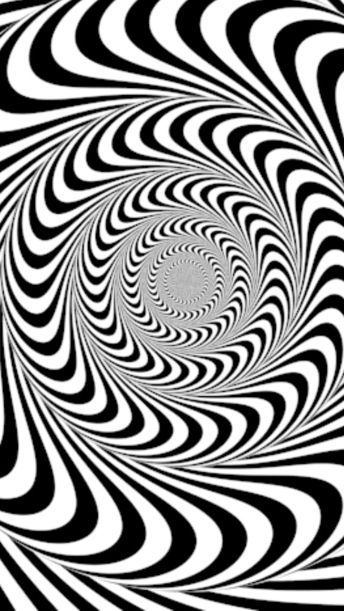

Slide 8


Slide 9


Slide 10
Psychoanalysis
Method of treating mental disorders
Emphasize how unconscious forces influence overt behavior and personality

Slide 11
Unconscious
The conscious mind contains all the thoughts, feelings, cognitions, and memories we acknowledge
The unconscious consists of deeper mental processes not readily available to the conscious mind
Freud believes that the unconscious mind is responsible for keeping information about threatening experiences and primal urges such as sex and aggression (aggressive behavior)

Slide 12
psychoanalytic therapy
Freud’s theory of psychoanalysis created the framework for psychoanalytic therapy: a deep, individualized form of talk therapy
Psychoanalytic therapy encompasses an open conversation that aims to uncover ideas and memories long buried in the unconscious mind
- spontaneous word association
- dream analysis
Freud observed that when the sources of patients’ ideas and impulses were brought into consciousness, the patients showed improvement

Slide 13
Psychoanalysis
Freud’s structure of personality: the id, ego, and superego
The id
- the unconscious,
- holds primitive desires and urges.
- isn’t rational or accessible, it is instinctual
The superego
- embodies a person’s higher moral code
- responsible for self-control, decision-making, and sacrifice
(abilities that allow an individual to live well with others in society)
- conflicts with the impulsive id

Slide 14
Psychoanalysis
The ego
- represents the self
- balances and resolves conflicts between two competing forces
- tasks of reality: perception, cognition, and executive actions

Slide 15
Examples of Psychoanalysis
A 20-year-old, well-built and healthy, has a seemingly irrational fear of mice. The fear makes him tremble at the sight of a mouse or rat. He often finds himself in embarrassing situations because of the fear. He feels that even the thought of touching or holding a mouse makes him quake in his boots. On psychoanalysis, it was revealed that he was bitten by a rat when he was a toddler. The wound bled a lot and he had to take injections and medications after that. Thus, an incident that happened years back still affects him and the way he reacts to situations. Several sessions were done to convince him that it was just a childhood experience and now he is strong enough to look after himself. It is not necessary that what happened years back will happen again.

Slide 16
Examples of Psychoanalysis
A lady finds it difficult to have a lasting relationship. She says she does not trust men. She had been in several short-term relationships that ended mainly because her partners found her too indulgent and controlling. She would check their phones and emails without their permission. She would feel that she was not worthy and maybe cheated by others. She had an intense fear of being betrayed or harmed. On digging deeper into her thought process, she revealed that her parents had a stressful marriage. Her father would physically harm her mother. He abandoned the family when she was 5 years old. She feels that all men may be like her father and would harm her in some way.

Slide 17
Behaviorism
Emerged in the early 1900s
Response to other popular schools of thought at the time (Freudian psychology)
Aimed to transform psychology into a more objective scientific discipline
argued that because such internal cognitions could not be measured or documented, they were not relevant for the study of human behavior

Slide 18
Behaviorism
Seek to explain human behavior
Believes that human behavior is shaped by the environment
Doesn’t focus on internal thoughts, instead focuses on behavioral outputs
Emphasizes stimuli and response
behavioral therapy techniques are used to help with developing new skills, connecting the steps required to complete a task, and rewarding desired behavior,
Laid the groundwork for understanding how we learn

Slide 19
Classical Conditioning
a form of learning in which the repeated pairing of two stimuli will cause an organism to respond to one stimulus as if the other was present, even when it isn’t

Slide 20
Classical Conditioning
Neural Stimulus: A stimulus that does not initially elicit a response
Unconditioned Stimulus: A stimulus that elicits a reflexive response
Unconditioned Response: A natural reaction to a given stimulus
Conditioned Stimulus: A stimulus that elicits a response after repeatedly being paired with an unconditioned stimulus
Conditioned Response: The response caused by the conditioned stimulus

Slide 21
Pavlov’s Dog Experiment
Conducted in 1890s by Ivan Pavlov
Classical Conditioning

Slide 22
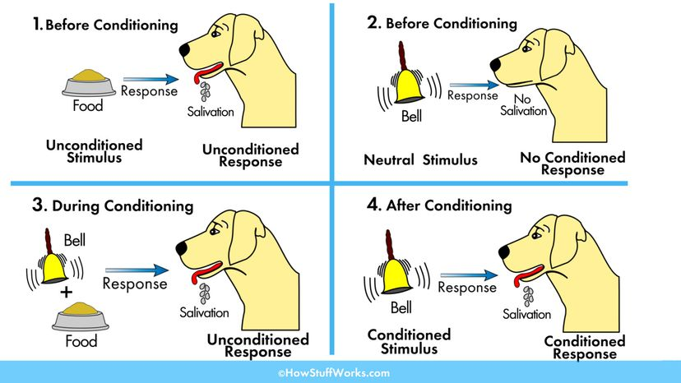
Pavlov’s Dog Experiment

Slide 23
Little Albert Experiment
1920
Study Conducted by John Watson
Classical conditioning and generalization

Slide 24
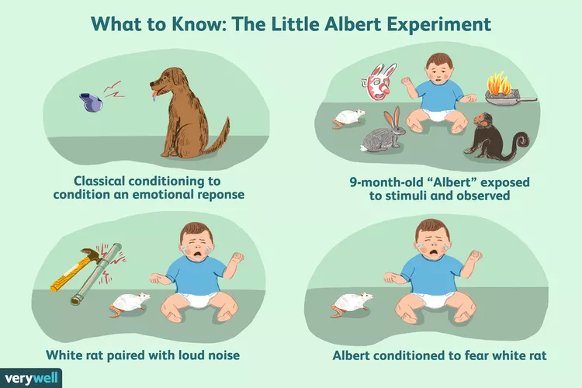
Little Albert Experiment

Slide 25
Little Albert Experiment
Criticism and Ethical Issues
the experimental design and process were not carefully constructed. Watson and Rayner did not develop an objective means to evaluate Albert's reactions, instead of relying on their own subjective interpretations
Little Albert was harmed during this experiment—he left the experiment with a previously nonexistent fear. By today's standards, the Little Albert experiment would not be allowed

