Slide 1
Psychology and life
Session 4: Intro to Psychology
Lillian Liao Culver Academies

Slide 2
Perspectives
Structuralism
Functionalism
Gestalt Psychology Psychoanalysis
Behaviorism
Humanistic
Cognitivism

Slide 3
Humanistic Psychology

Slide 4
Humanistic Psychology
Criticism of Freudian psychology and Behaviorism
- believes that it has a dark, pessimistic view on human nature
Founded by Abraham Maslow and Carl Rogers.
believes that humans have great potential of growth
Believes that people are innately good and that mental and social problems result from deviations from this natural tendency
stresses the importance of self-actualization
Therapists should encourage this through nonjudgmental support

Slide 5
Maslow's Hierarchy of needs

Slide 6
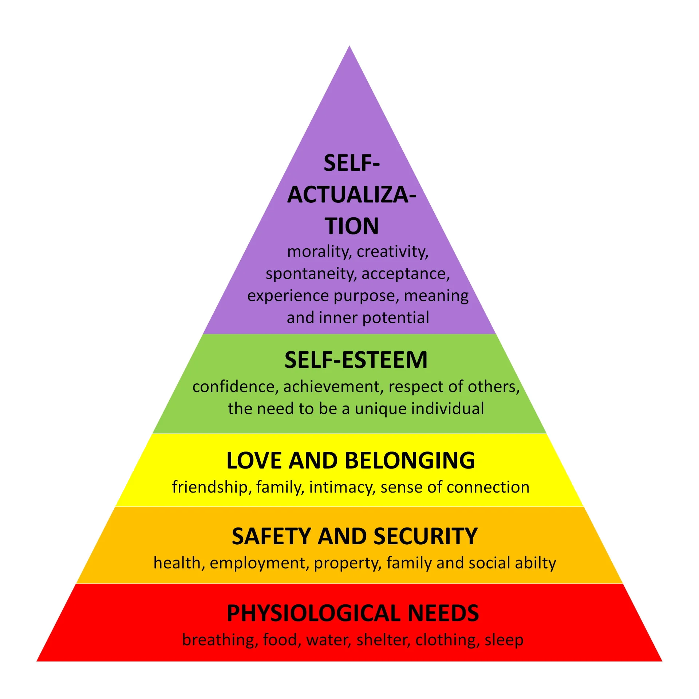
Maslow's Hierarchy of needs

Slide 7
Growth Needs
&
Deficiency needs

Slide 8
Positive Psychology
&
Transpersonal Psychology

Slide 9
Cognitive psychology
Focuses on mental processes
It emphasizes the role of cognition, or mental activities and processes, in understanding human behavior
Criticize Behaviorism as it focuses only on behavior and neglected to explain cognition
Studies internal mental processes:
perception
thinking
memory
attention
language
problem-solving
learning

Slide 10
Perception
includes the five senses; touch, sight, sound, smell, and taste
We perceive our environment using each of these, often simultaneously (parallel processing)
Different types of perception in psychology:
Person perception: refers to the ability to identify and use social cues about people and relationships
Social perception: is how we perceive certain societies and can be affected by things such as stereotypes and generalizations
Selective perception: paying attention to some parts of our environment while ignoring others

Slide 11
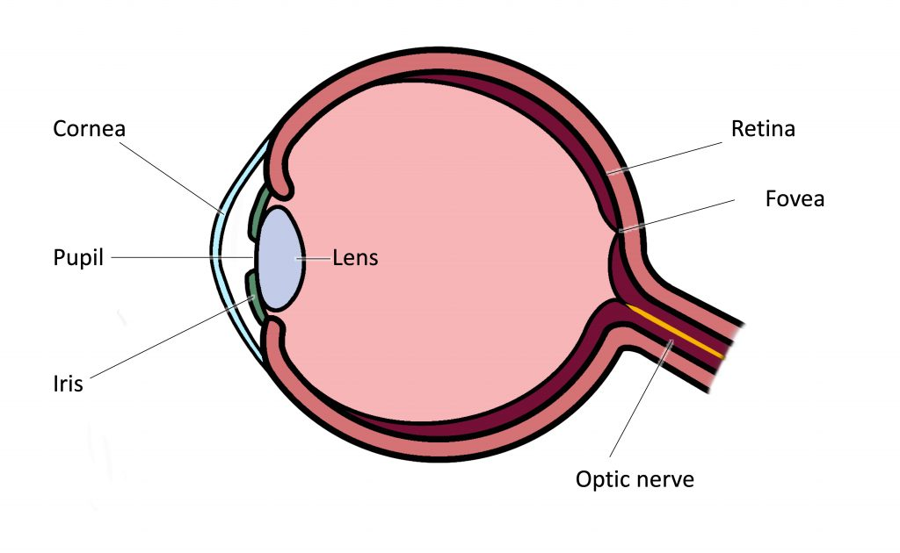
The Eye
Cornea （角膜）: helps focus the light as it enters
Iris: controls the size of the pupils to determine how much light to let in
The cornea and lens act together to project an inverted image onto the retina
Retina （视网膜）: where visual information is being processed

Slide 12
Perception process
Environmental stimulus: stimuli that attracts your attention
Attended stimulus: specific thing your attention is focused on
Image on the retina: image is being seen by your eyes
Transduction: image in your eyes in transformed into electric signals
Neural processing: different neural pathways that goes to your brain
Perception: you become consciously aware of the stimuli
Recognition: interpret what you are sensing
Action: your response

Slide 13
Parallel processing
Refers to our ability to deal with multiple stimuli simultaneously
e.g., when you are doing homework, you are also able to listen to music
How does parallel processing work?
In parallel processing, we take in multiple different forms of information at the same time, especially for vision
e.g., when you see a bus coming towards you, you see its color, shape, depth, and motion all at once.
If you had to assess things one at a time, it would take far too long. Seeing things together enables you to quickly determine what you're seeing and make a response

Slide 14
Parallel processing
Parallel processing also relies on a combination of top-down and bottom-up processing

Slide 15
Top-down processing
involves using your past experiences, expectations, and knowledge to make sense of your perceptions
e.g., if you see an animal running toward you, top-down processing will enable you to interpret whether you're seeing your dog running to greet you or another animal running to attack you.
Thoughts
Senses

Slide 16
Examples of
Top-down processing
Making assumptions based on prior knowledge
Drawing conclusions from limited data
Interpreting what someone says based on context clues
Using predictions to fill in missing information

Slide 17
Examples of
Top-down processing
If you see a building is on fire, what would you do _____________
锄禾日当午_____________
Wh_t is yo_r n_me

Slide 18
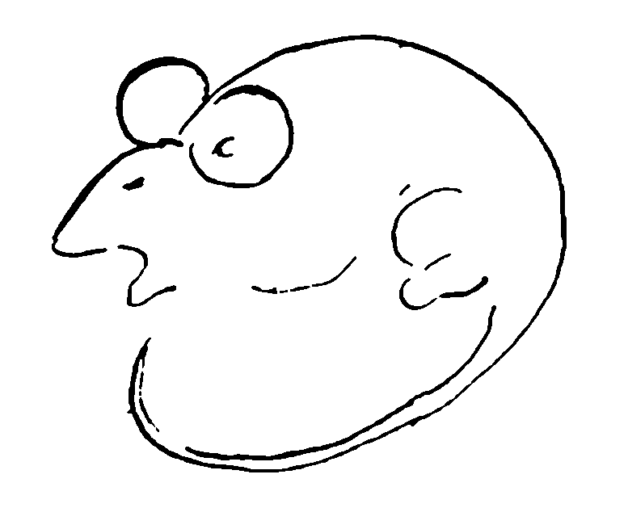

Slide 19


Slide 20
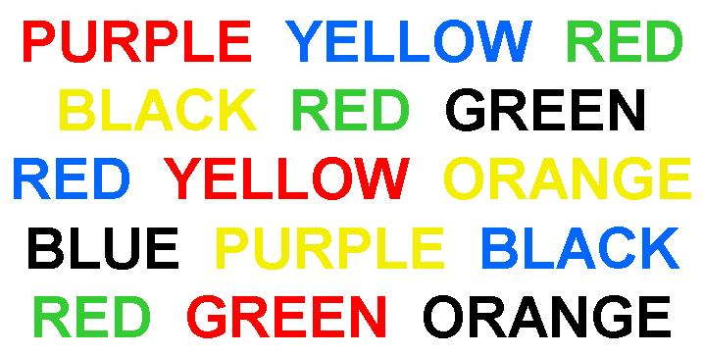

Slide 21
The Stroop Effect
This is an example of top-down processing because we understand and process the concept of reading the words in front of us rather than identifying the color

Slide 22
Bottom-up processing
Doesn't use any previous knowledge to assess information
Begins when our senses take in the most basic aspects of a stimulus, then our brain uses that data to form a complete picture of the information
“Data-driven processing”
Thoughts
Senses

Slide 23
Examples of
Bottom-up processing
Interpreting road signs when driving

Slide 24

Examples of
Bottom-up processing
Prosopagnosia (脸盲症）
Patients with Prosopagnosia don’t use top-down processing to identify individuals. They can take in what they see when they look at a person’s face
They can identify whether the person has freckles, blue eyes, or a crooked nose. But they can’t identify whether or not they have seen that face before, or who it belongs to.

Slide 25
Automaticity
While we use parallel processing all the time in our daily lives, many people are able to increase their ability to parallel process in specialized areas of their lives through practice
For instance, people who type on a daily basis will become experts, and this will reduce the number of cognitive resources the individual must dedicate to typing to the point where this task may require minimal or no thought.

Slide 26
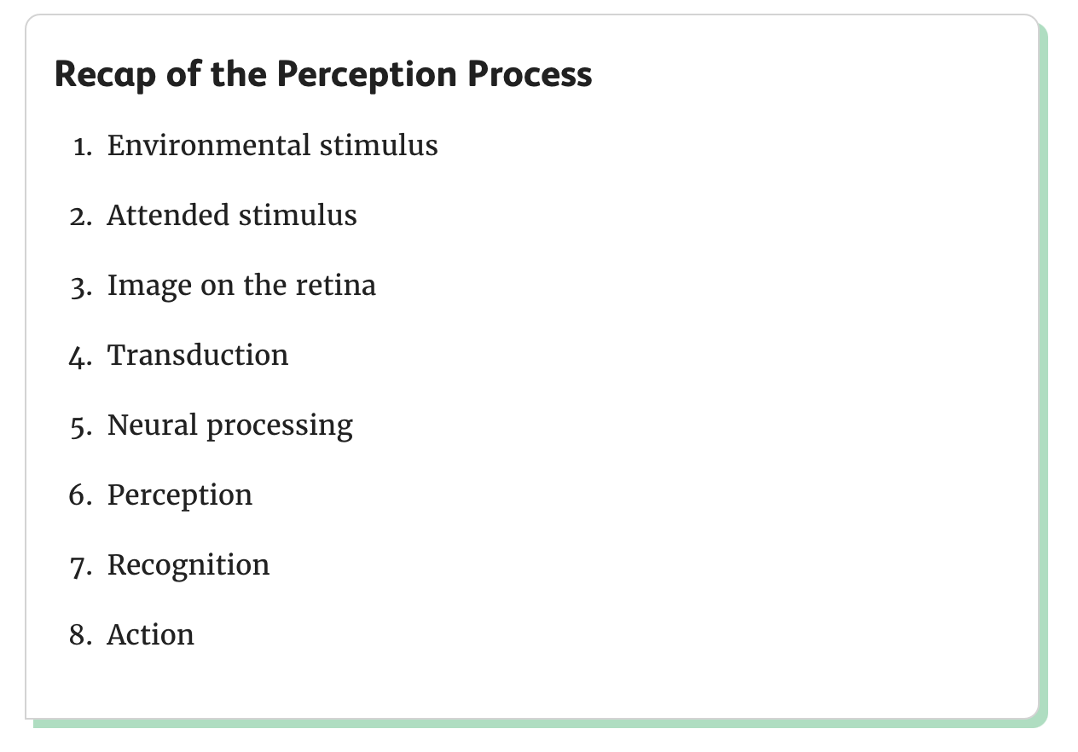
Perception recap

Slide 27
What is parallel processing?

Slide 28
What is top-bottom processing?

Slide 29
What is bottom-up processing?

